Slide 1
Introduction of Socle Technology
Presenter:
1/17/24

Slide 2
Channel Service

Slide 3

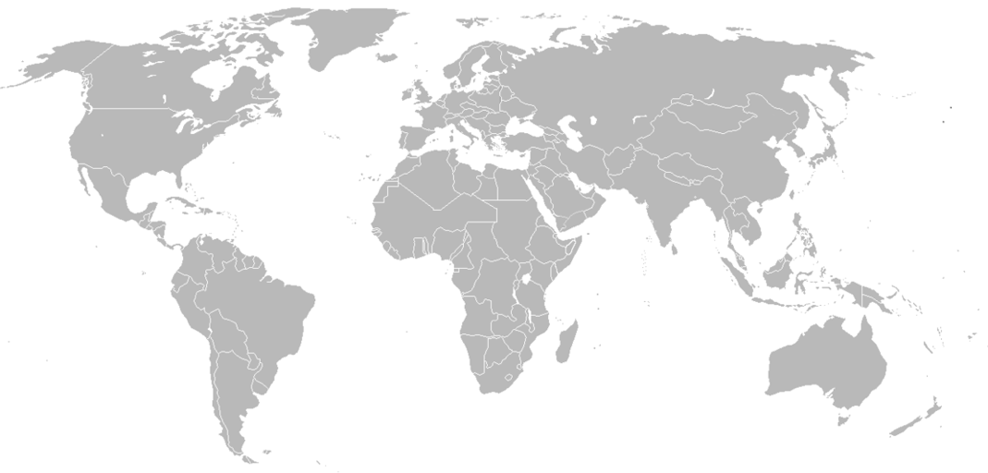



World Wide Sales Channel：Locations and Values
Representing Foxconn Group Brands at several regions
Plenty connections, sales routes around the world
Experienced FAE in consumer electronics, such as Air purifier, Camera, Distance ranging, Robot…etc.
Leveraging engineering resource in Foxconn group for building up sensor modules
Global online Distributors
Socle Reps / Distributors
Socle Sales Office
Notes:
Socle藉由銷售Sharp電子原器件產品,在各個區域建立起相關的銷售渠道以及當地的銷售人員. 在銷售鴻海集團產品的同時,也在世界各地尋找有競爭力的產品,試圖帶回集團做出貢獻
Socle有建立起FAE團隊,專精於消費性產品。
Socle同時也可利用鴻海集團的工程資源, 能將傳給器組成模組, 或者是將模組在更進一步組成系統的能力。
負責區域: 中國、美國 、東南亞、印度
自有Office:上海、杭州、深圳、台灣、加拿大

Slide 4
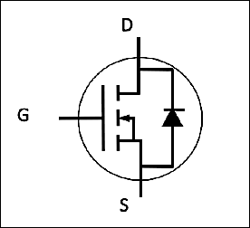






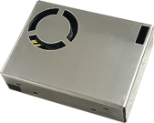



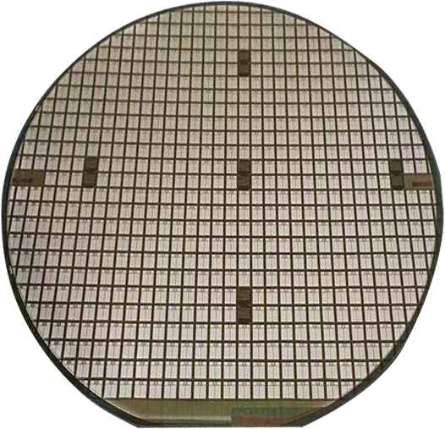
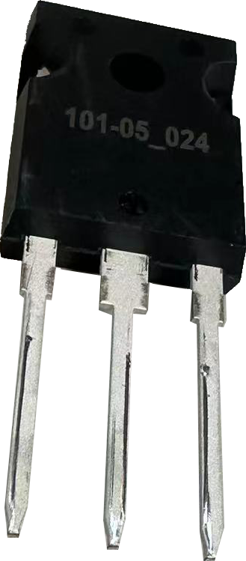






Product Line
Sensors
Wi-Fi 4/5/6 (+BT) Wireless Module
Power Isolation
Power Semiconductor
Photo coupler
Photo-interrupter
PM2.5 sensor
Gate Driver
Distance Measurement Sensor
Laser
SiC MOSFET
TOF sensor & module
MEMS Mic
Laser Diode
Sensing
Computing
Communication
Control
Notes:
To247 想個圖 一個晶圓

Slide 5
Power Semiconductor

Slide 6

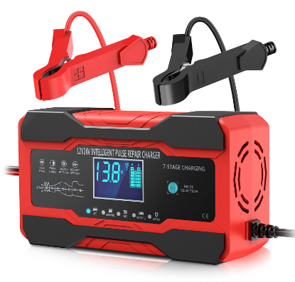
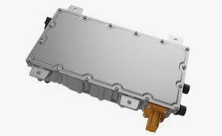
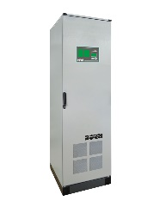


Power Semiconductor – SiC MOSFET
Applications
Battery Chargers
DC/DC converters
Industrial Inverter
Features
Item | Parameter
Drain-Source Breakdown Voltage | 1200 | 1700V
RDS | 12, 16, 20, 40, 70mohm | 40mohm, 1ohm, 50ohm
Guaranteed performance over temperature | 25°C ~ +175°C.

Slide 7
Power Semiconductor – SiC MOSFET Product List
Emerald series | Gen 1 |  |  |  |  | Gen 2
 | 1200V
 | 12mohm | 16mohm | 20mohm | 40mohm | 70mohm | 16mohm
Drain-Source Breakdown Voltage (BV) | 1200V | 1200V | 1200V | 1200V | 1200V | 1200V
Gate-source threshold voltage (Vth) | 2.9V | 2.9V | 2.9V | 2.9V | 2.9V | 3V
Drain-source on-state resistance (Ron) | 12mohm | 16mohm | 20mohm | 40mohm | 70mohm | 16mohm
Continuous DC drain current (Id) | 125A | 105A | 85A | 55A | 35A | 100A
Gate-to-drain charge (Qgd) | 95nc | 69nc | 55nc | 35nc | 27nc | 94nc
Rutile series Gen 2 | 1200V
 | 12mohm | 16mohm | 20mohm | 40mohm | 70mohm
Drain-Source Breakdown Voltage (BV) | 1200V | 1200V | 1200V | 1200V | 1200V
Gate-source threshold voltage (Vth) | 2.9V | 2.9V | 2.9V | 2.9V | 2.9V
Drain-source on-state resistance (Ron) | 12mohm | 16mohm | 20mohm | 40mohm | 70mohm
Continuous DC drain current (Id) | 135A | 110A | 90A | 55A | 35A
Gate-to-drain charge (Qgd) | 94nc | 70nc | 55nc | 28nc | 16nc

Slide 8
Power Isolation

Slide 9
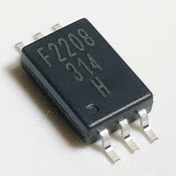
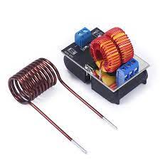
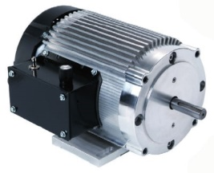



Power Isolation - Gate Driver Photocoupler
Applications
AC brushless
Induction Heating
Industrial Inverter
Features
Anode
V_{CC}
Item | Parameter
Maximum peak output current | 0.8A, 1A, 3A, 4A
Rail-to-rail output voltage | Yes
Maximum propagation delay | 110 ns
Under Voltage Lock-Out protection (UVLO) with hysteresis | Yes
Wide operating range | 10 to 30 Volts (VCC)
Guaranteed performance over temperature | -40°C ~ +110°C.
Safety approval | UL, VDE, CQC
V_{O}
Cathode
V_{SS}

Slide 10
Power Isolation - Gate Driver Photocoupler
Selection Table
Part number | Package | Status | Peak Output Current (A) | V_{iso} (Vrms) | V_{CC} (V) | T_{PLH}/T_{PHL} (Max) | T_{OPR} (℃)
FSS-5701P/W-T1V | LSOP6 | MP | 0.8 | 5000 | 10 ~ 30 | 110ns | -40 ~ 110
FSS-314P/W-T1V | LSOP6 | MP | 1 | 5000 | 10 ~ 30 | 110ns | -40 ~ 110
FSS-341P/W-T1V | LSOP6 | MP | 3 | 5000 | 15 ~ 30 | 110ns | -40 ~ 110
FSS-343P/W-T1V | LSOP6 | MP | 4 | 5000 | 15 ~ 30 | 110ns | -40 ~ 110
Cross Reference
Gate Driver
Part number | Package | Feature | BROADCOM | TOSHIBA
FSS-5701P/W-T1V | LSOP6 | 0.8A | --- | ---
FSS-314P/W-T1V | LSOP6 | 1A | ACPL-P314 | TLP5701
FSS-341P/W-T1V | LSOP6 | 3A | ACPL-P341 | TLP5754
FSS-343P/W-T1V | LSOP6 | 4A | ACPL-P343 | TLP5754

Slide 11
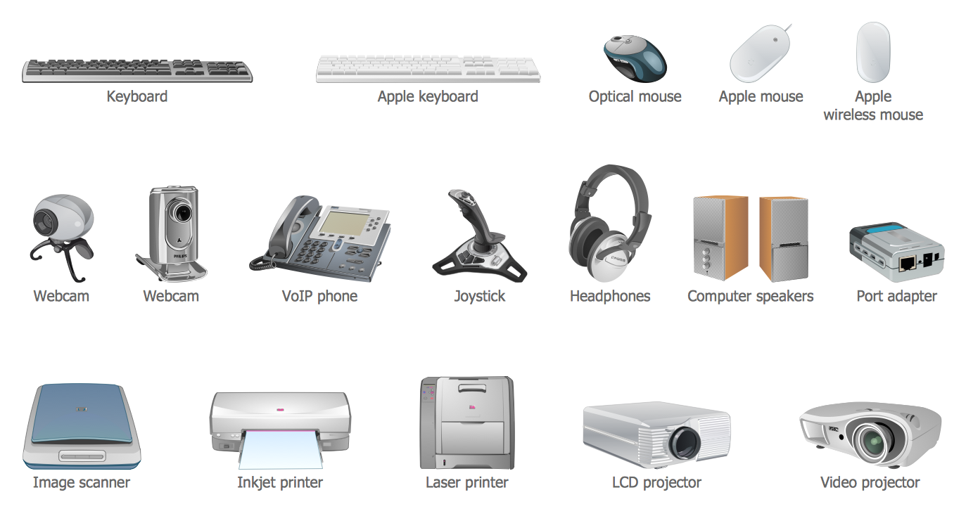
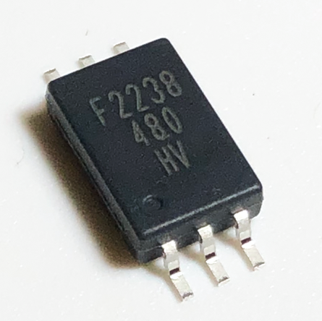
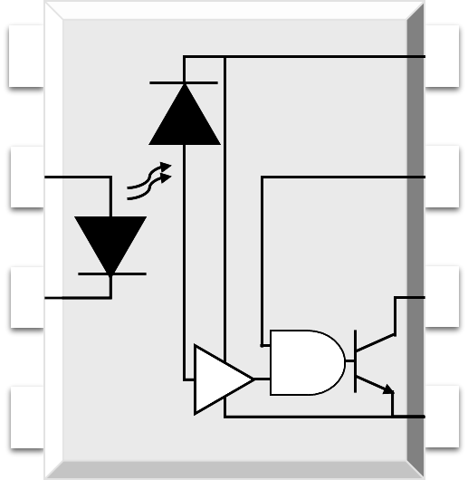
Photocoupler - High Speed
Applications
  Ground loop elimination
  LSTTL to TTL
  LSTTL or CMOS
  Line receiver
  data transmission
  Switching power supply
  Pulse transformer replacement
  Computer peripheral interface
NC 1
8 V_{CC}
Features
Anode 2
7 V_{E}
Item | Parameter
Switching Speed | 1M & 10M bit/s Max
High isolation | 5000 VRMS
DC input with logic gate output | Yes
Operating temperature range | - 55 °C to 100 °C
MSL | Class 1
Cathode 3
6 V_{O}
NC 4
5 GND

Slide 12

Photocoupler - High Speed
Selection Table
Part number | Package | Status | Feature | V_{iso} (Vrms) | V_{CC} (V) | T_{PLH}/T_{PHL} (Max) | T_{OPR} (℃)
FSS-480P/W-T1V | LSOP6 | MP | IPM, Positive output | 5000 | 35 | 250ns | -55~110
FSS-481P/W-T1V | LSOP6 | MP | IPM, Negative output | 5000 | 35 | 250ns | -55~110
FSS-611P/W-T1V | LSOP6 | MP | 10M | 5000 | 3.3/5 | 75ns | -40~110
FSS-50LP/W-T1V | LSOP6 | MP | 1M | 5000 | 3.3/5 | 75ns | -40~110
Cross Reference
High Speed
Part number | Package | Feature | BROADCOM | TOSHIBA
FSS-480P/W-T1V | LSOP6 | IPM, Positive output | ACPL-P480 | TLP2710
FSS-481P/W-T1V | LSOP6 | IPM, Negative output | ACPL-P481 | TLP2710
FSS-611P/W-T1V | LSOP6 | 10M High Speed | ACPL-P483 | TLP2748
FSS-50LP/W-T1V | LSOP6 | 1M High Speed | ACPL-W50L | TLP2719 (LF4)

Slide 13
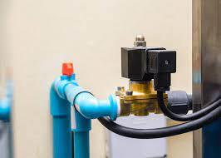
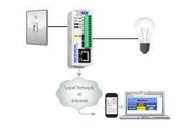
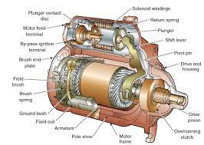
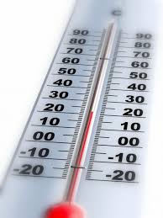
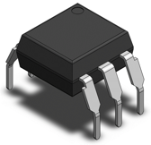
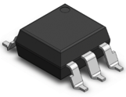
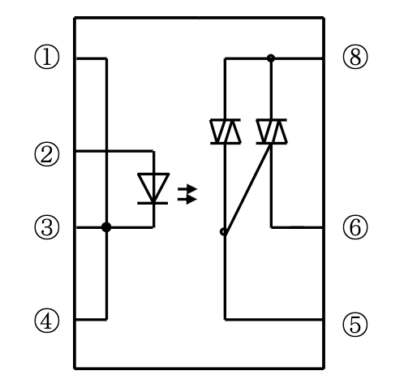
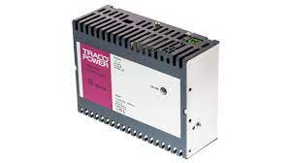
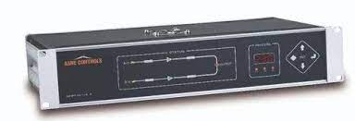
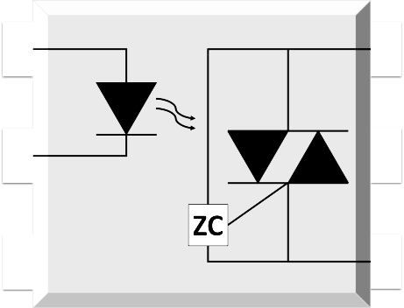
Photocoupler - Phototriac
Applications
Solenoid / valve controls
Lighting controls
Motor controls
Temperature controls
Anode 1
6 Terminal
Static AC power switches
Solid state relays
Interfacing microprocessors to 115 to 240V AC peripherals
Cathode 2
5 Substrate
NC 3
4 Terminal
Features
Item | Parameter
High isolation | 5000 VRMS
DC input with zero-cross / random-phase photo triac output | v
Operating temperature range | - 40 °C to 100 °C
REACH & RoHS compliance | v
MSL | Class 1
Safety approval | UL, VDE, and CQC
Notes:
Description
The 305X and 306X series combine an AlGaAs infrared emitting diode as the emitter which is optically coupled to a monolithic silicon random-phase photo triac in a plastic DIP6 package with different lead forming options.

Slide 14


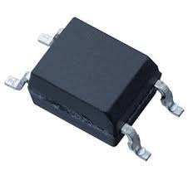
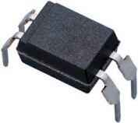
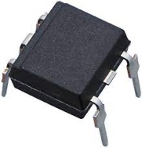
Photocoupler - Phototriac
Selection Table
Part number | Package | Status | Feature | V_{iso} (Vrms) | V_{CC} (V) | T_{PLH}/T_{PHL} (Max) | T_{OPR} (℃)
FSS-305XP/W-T1V | DIP6 | MP | Z.C | 5000 | 15,10,5 | 600 | 55~110
FSS-306XP/W-T1V | DIP6 | MP | R.P | 5000 | 15,10,5 | 600 | 55~110
Part number | Package | Applied voltage | Feature |  | ON-state current
S2S3A00F / S2S5A00F / S2S5FA0F | Mini-flat 4-pin | AC 200 V lines | 200 V lines, compact |  | 0.05 A
S2S4A00F | Mini-flat 4-pin | AC 200 V lines | 200 V lines, compact | Built-in zero-cross circuit | 0.1 A
PC3SH11YFZAH / PC3SH13YFZAH | DIP4 | AC 200 V lines | Reinforced isolation |  | 0.1 A
PC3SH21YFZBH | DIP4 | AC 200 V lines | Reinforced isolation | Built-in zero-cross circuit | 0.1 A
PC3SD12NTZAH / PC3SD11NTZBH / PC3SD11NTZCH | DIP4 | AC 200 V lines | General purpose |  | 0.1 A
PC3SD21NTZAH / PC3SD21NTZBH / PC3SD21NTZDH | DIP6 | AC 200 V lines | Reinforced isolation | Built-in zero-cross circuit | 0.1 A
PC3SF11YVZAH / PC3SF11YVZBH | DIP6 | AC 200 V lines | Reinforced isolation |  | 0.1 A
PC3SF21YVZAH / PC3SF21YVZBH | DIP6 | AC 200 V lines | General purpose | Built-in zero-cross circuit | 0.1 A
PC4SD11NTZCH | DIP6 | AC 200 V lines | General purpose |  | 0.1 A
PC4SD21NTZCH / PC4SD21NTZDH | DIP6 | AC 200 V lines | Reinforced isolation | Built-in zero-cross circuit | 0.1 A
PC4SF11YTZBH | DIP6 | AC 200 V lines | Reinforced isolation |  | 0.1 A
PC4SF21YVZBH / PC4SF21YWPSH | DIP6 | AC 200 V lines |  | Built-in zero-cross circuit | 0.1 A

Slide 15

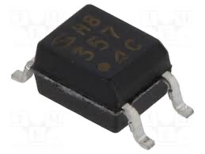
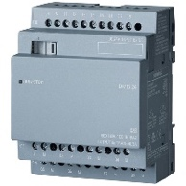
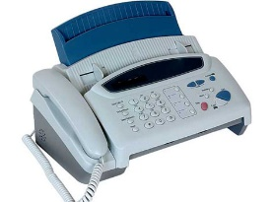
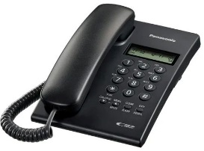
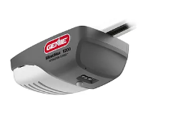

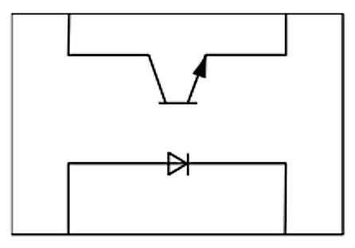
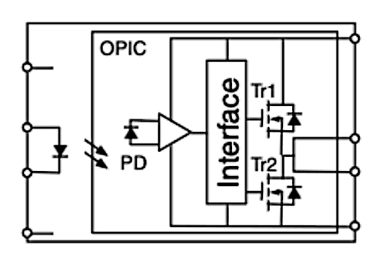



Power Isolation - Photocoupler
Applications
Programmable controller
Facsimiles
Telephones
Garage door opener
Process control
Features
Item | Parameter
Double transfer mold package | DIP4, DIP8
High collector-emitter voltage | VCEO : 80V
High isolation voltage between input and output | 5 kV
Current transfer ratio | 50%
Safety approval | UL, VDE, CQC
Notes:
＊北美賣哪些大客人 換

Slide 16
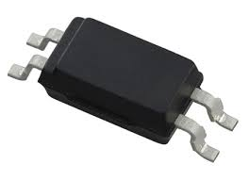
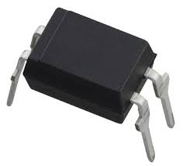
Power Isolation - Photocoupler - Transistor output
Selection Table
Part number | Package | Output type | Feature
PC357NJ0000F / PC451J00000F | Mini-flat 4-pin | Single phototransistor | High collector-emitter voltage
PC367NJ0000F | Mini-flat 4-pin | Darlington phototransistor | AC input response | Low input current
PC354NJ0000F | Mini-flat 4-pin | Darlington phototransistor | AC input response
PC364NJ0000F | Mini-flat 4-pin | Darlington phototransistor | High sensitivity, High collector-emitter voltage | Low input current
PC355NJ0000F / PC452J00000F | Mini-flat 4-pin | Darlington phototransistor | High sensitivity, High collector-emitter voltage
PC365NJ0000F | Mini-flat 4-pin | Single phototransistor | General purpose | Low input current
PC3H7J00001H | Compact half pitch | Single phototransistor | General purpose
PC3HU7xYIP1B | Compact half pitch | Single phototransistor | AC input response | Reinforced insulation
PC3H71xNIP1H | Compact half pitch | Single phototransistor | AC input response | Low input current
PC3H3J00001H / PC3H4J00001H | Compact half pitch | Single phototransistor | AC input response
PC123XxYSZ1B | DIP4 | Single phototransistor | Reinforced insulation
PC1231xNSZ1B | DIP4 | Darlington phototransistor | High collector-emitter voltage | Low input current
PC817XxNSZ1B / PC851XNNSZ1H | DIP4 | Darlington phototransistor | High collector-emitter voltage
PC8171xNSZ1B | DIP4 | Darlington phototransistor | High sensitivity, High collector-emitter voltage | Low input current
PC852XNNSZ1H | DIP4 | Darlington phototransistor | High sensitivity, High collector-emitter voltage

Slide 17
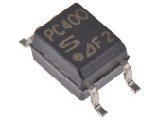
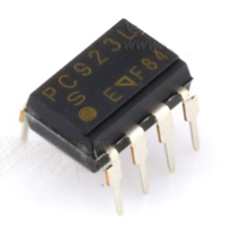
Power Isolation - Photocoupler - OPIC output
Selection Table
Part number | Package | Output type | Feature
PC400J00000F / PC410LENIP0F | Mini-flat 5-pin | Digital output | General purpose, High response speed
PC457L0NIP0F | Mini-flat 5-pin | Analog/Digital output | High CMR
PC923LRNSZ0F | DIP8 | Built-in base amplifier | For inverter control | 1.5A output
PC925LENSZ0F | DIP8 | Built-in base amplifier | For inverter control | 2.5A output

Slide 18
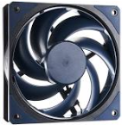
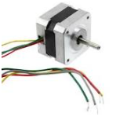

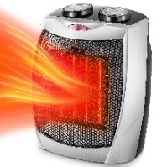
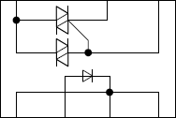

Power Isolation - Solid State Relay
Applications
Heaters
Fans
Motors
White Goods
Features
Item | Parameter
Zero crossing functionary | VOX : MAX. 35V
High repetitive peak off-state voltage | VDRM : 400V ; 600V
High isolation voltage between input and output | Viso( rms ) : 4.0kV
Superior noise immunity | dV/dt : MIN. 100V/µs
Safety approval: | UL, VDE, CQC
Notes:
白電 替換

Slide 19
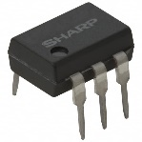
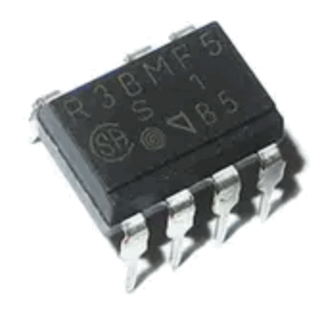
Power Isolation - Solid State Relay
Selection Table
Part number | Package | Applied voltage | Feature | ON-state current
PR31MA11NTZH | DIP6 | AC 200 V lines | General purpose | 0.06 A
PR32MA11NTZH | DIP6 | AC 200 V lines | General purpose | 0.15 A
PR33MF5 series / PR36MF5 series / PR39MF5 series / PR3BMF5 series | DIP8 | AC 200 V lines | General purpose | 0.3 / 0.6 / 0.9 / 1.2 A
PR36MF2 series / PR39MF2 series | DIP8 | AC 200 V lines | Built-in zero-cross circuit | 0.6 / 0.9 A

Slide 20
Laser Diode

Slide 21

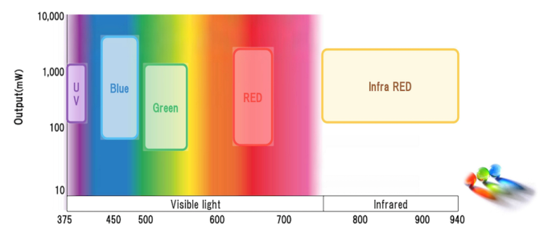
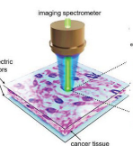

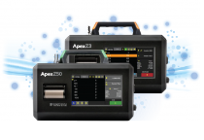

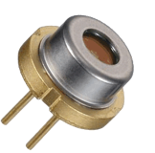
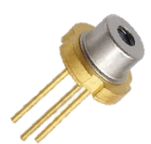
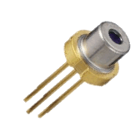



Laser Diode - UV / Blue
Applications
biologically relevant
Life Sciences related
Particle Counter
VR/AR
Features
ø9 mm Can
ø5.6 mm Can
ø3.8 mm Can
Item-UV laser Diode | Parameter
Can Package | ø5.6 mm
Wavelength (nm) | 395 nm ~ 406 nm
Absolute Maximum rating Po (mW) | 1100 mW
Absolute Maximum rating Iop (mA) | 650 mA
Item-Blue laser Diode | Parameter
Can Package | ø3.8 mm , ø5.6 mm, ø9 mm
Wavelength (nm) | 435 nm ~ 487 nm
Absolute Maximum rating Po (mW) | 2000 mW
Absolute Maximum rating Iop (mA) | 4300 mA
ø3.3 mm Can
t1.8 mm Frame

Slide 22
Laser Diode - UV / Blue
Selection Table
Color | Part No. | Wavelength(Peak)Ap(nm) | Absolute maximum rating*1 Po(mW) | Absolute maximum rating*1 Iop(mA) | Absolute maximum rating*1 Top(C) | Po(mW) | Ith(mA) | lop(mA) | Vop(V) | ηd(mW/mA) | λp(nm) | Θ//(°) | Θ⊥(°) | FFP | Packaging | Monitor PD (Built-in:O)
UV | GH0393AA2G | 395 | 350 | - | O to +30 | 300 | 150 | 310 | 4.4 | 1.8 | 395 | 13 | 44 | *3 | ø5.6 | -
UV | GH0401FA2G | 405 | 155 | - | -10 to +75 | 150 | 40 | 130 | 5 | 1.7 | 405 | 9 | 19 | *2 | ø5.6 | -
UV | GH0401FA2K | 405 | 155 | - | -10 to +75 | 150 | 40 | 130 | 5 | 1.7 | 405 | 9 | 19 | *2 | ø5.6 | O
UV | GH04W10A2GC | 406 | 350 | - | 0 to +50 | 300 | 140 | 325 | 4.5 | 1.8 | 406 | 14 | 41 | *3 | ø5.6 | -
UV | GH0406AA2G | 405 | 700 | - | O to +30 | 600 | 120 | 420 | 4.4 | 2 | 405 | 16 | 38 | *3 | ø5.6 | -
UV | GH04V01A2G | 405 | 1100 | - | O to +30 | 1000 | 125 | 625 | 5 | 2 | 405 | 16 | 40 | *3 | ø5.6 | -
Blue | GH04C05W9G | 435 | - | 3600 | O to +45 | 5000 | 350 | 3100 | 4.5 | 1.8 | 435 | 9 | 47 | *3 | ø9.0 | -
Blue | GH04C05W9G | 435 | - | 3000 | 45 to +60 | 5000 | 350 | 3100 | 4.5 | 1.8 | 435 | 9 | 47 | *3 | ø9.0 | -
Blue | GH04C05V9G | 440 | - | 3500 | 0 to +35 | 5000 | 350 | 3100 | 4.6 | 1.9 | 440 | 10 | 47 | *3 | ø9.0 | -
Blue | GH04C03Z9G | 450 | - | 2800 | O to +60 | 3500 | 260 | 2100 | 4.4 | 1.85 | 450 | 9 | 47 | *3 | ø9.0 | -
Blue | GH04C06X9G | 450 | - | 4300 | O to +60 | 6000 | 300 | 4000 | 4.8 | 1.55 | 450 | 9 | 48 | *3 | ø9.0 | -
Blue | GH04580A2G | 450 | 85 | - | -10 to +70 | 80 | 22 | 84 | 5.1 | 1.3 | 450 | 10 | 24 | *2 | ø5.6 | -
Blue | GH04C01A2G | 450 | 1650 | - | -10 to +50 | 1600 | 200 | 1200 | 5 | 1.5 | 450 | 6.5 | 23 | *2 | ø5.6 | -
Blue | GH04C01B2G | 450 | 2000 | - | -10 to +50 | 1800 | 110 | 1100 | 4.1 | 1.8 | 450 | 7 | 26 | *2 | ø5.6 | -
Blue | GH04590A5G | 450 | 95 | - | -10 to +50 | 90 | 28 | 100 | 5.2 | 1.3 | 450 | 9 | 24 | *2 | ø3.8 | -
Blue | GH04850B2G | 487 | 55 | - | -10 to +60 | 50 | 40 | 105 | 6 | 0.8 | 487 | 8 | 23 | *2 | ø5.6 | -
ø9 mm Can
ø5.6 mm Can
ø3.3 mm Can
ø3.8 mm Can
t1.8 mm Frame

Slide 23




Laser Diode - Green / Red
Applications
Robotic pool cleaner
Projector
Laser Distance Meter
Measuring Device
Life Sciences related
Features
Item-Green laser Diode | Parameter
Can Package | ø3.8 mm , ø5.6 mm, ø9 mm, t1.8 mm
Wavelength (nm) | 515 nm ~ 520 nm
Absolute Maximum rating Po (mW) | 135 mW
Absolute Maximum rating Iop (mA) | 1650 mA
Item-Red laser Diode | Parameter
Can Package | ø3.3 mm ,ø3.8 mm, ø5.6 mm, ø9 mm, t1.8 mm
Wavelength (nm) | 638 nm ~ 660nm
Absolute Maximum rating Po (mW) | 1210 mW
Absolute Maximum rating Iop (mA) | 1600 mA
ø9 mm Can
ø5.6 mm Can
ø3.8 mm Can
ø3.3 mm Can
t1.8 mm Frame

Slide 24
Laser Diode - Green
Selection Table
Color | Part No. | Wavelength(Peak)Ap(nm) | Absolute maximum rating*1 Po(mW) | Absolute maximum rating*1 Iop(mA) | Absolute maximum rating*1 Top(C) | Po(mW) | Ith(mA) | lop(mA) | Vop(V) | ηd(mW/mA) | λp(nm) | Θ//(°) | Θ⊥(°) | FFP | Packaging | Monitor PD (Built-in:O)
Green | GH15230H8C | 515 | 35 | - | -10 to +60 | 30 | 30 | 90 | 7 | 0.5 | 515 | 7.5 | 22 | *2 | t1.8 | -
Green | GH05230H2KC | 520 | 35 | - | -10 to +60 | 30 | 25 | 70 | 6.5 | 0.65 | 520 | 7 | 22 | *2 | ø5.6 | O
Green | GH05250F2K | 520 | 55 | - | -10 to +60 | 50 | 40 | 100 | 5.9 | 0.7 | 520 | 7 | 22 | *2 | ø5.6 | O
Green | GH05280E2KC | 520 | 85 | - | -10 to +60 | 80 | 50 | 150 | 6.5 | 0.8 | 520 | 7 | 23 | *2 | ø5.6 | O
Green | GH05280E5K | 520 | 85 | - | -10 to +60 | 80 | 65 | 180 | 6.5 | 0.7 | 520 | 7 | 23 | *2 | ø3.8 | O
Green | GH0521DE2G | 520 | 135 | - | -10 to +60 | 130 | 70 | 270 | 6.7 | 0.65 | 520 | 8 | 22 | *2 | ø5.6 | -
Green | GH05290A5G | 520 | 95 | - | -10 to +50 | 90 | 60 | 185 | 6.75 | 0.7 | 520 | 7 | 23 | *2 | ø3.8 | -
Green | GH0521DE5G | 520 | 135 | - | -10 to +50 | 130 | 70 | 270 | 6.7 | 0.65 | 520 | 8 | 22 | *2 | ø3.8 | -
Green | GH0523AD2G | 520 | - | 850 | O to +60 | 300 | 100 | 500 | 5.2 | 0.75 | 520 | 7 | 23 | *2 | ø5.6 | -
Green | GH05C01A9G | 520 | - | 1400 | O to +60 | 600 | 180 | 1050 | 5.2 | 0.7 | 520 | 9 | 44 | *3 | ø9.0 | -
Green | GH05C01C9G | 520 | - | 2000 | O to +60 | 1000 | 250 | 1650 | 5.2 | 0.7 | 520 | 9 | 45 | *3 | ø9.0 | -
ø9 mm Can
ø5.6 mm Can
ø3.3 mm Can
ø3.8 mm Can
t1.8 mm Frame

Slide 25
Laser Diode - Red
Selection Table
Color | Part No. | Wavelength(Peak)Ap(nm) | Absolute maximum rating*1 Po(mW) | Absolute maximum rating*1 Iop(mA) | Absolute maximum rating*1 Top(C) | Po(mW) | Ith(mA) | lop(mA) | Vop(V) | ηd(mW/mA) | λp(nm) | Θ//(°) | Θ⊥(°) | FFP | Packaging | Monitor PD (Built-in:O)
Red | GH06C01A9G | 640 | 1210 | 1600 | O to +45 | 1200 | 350 | 1400 | 2.25 | 1.15 | 640 | 11 | 35 | *2 | ø9.0 | -
Red | GH06C02B9G | 640 | - | (tbd) | O to +55 | 2500 | 600 | 2800 | 2.4 | 1.1 | 639 | 15 | 70 | *3 | ø9.0 | -
Red | GH06330A2G | 638 | 30 | - | -10 to +60 | 30 | 30 | 50 | 2.3 | 1.4 | 638 | 7 | 16 | *2 | ø5.6 | -
Red | GH0631IA2GC | 638 | 185 | - | -10 to +60 | 180 | 70 | 215 | 2.55 | 1.15 | 638 | 8 | 13 | *2 | ø5.6 | -
Red | GH0632BA2GC | 638 | 210 | - | -10 to +60 | 200 | 55 | 230 | 2.65 | 1.15 | 639 | 8 | 15 | *2 | ø5.6 | -
Red | GH0637AA2G | 638 | 702 | - | -10 to +40 | 700 | 110 | 810 | 2.46 | 1 | 638 | 16 | 35 | *2 | ø5.6 | -
Red | GH0631CA5GC | 638 | 120 | - | -10 to +60 | 120 | 50 | 150 | 2.5 | 1.2 | 638 | 8 | 15 | *2 | ø3.8 | -
Red | GH0631IA5G | 638 | 185 | - | -10 to +60 | 150 | 60 | 190 | 2.5 | 1.15 | 638 | 7.5 | 15 | *2 | ø3.8 | -
Red | GH1631AA8C | 638 | 100 | - | -10 to +60 | 100 | 50 | 130 | 2.45 | 1.2 | 638 | 8 | 15 | *2 | t1.8 | -
Red | GH0652CA2GC | 650 | 220 | - | -10 to +70 | 200 | 55 | 220 | 2.6 | 1.2 | 650 | 8 | 12.5 | *2 | ø5.6 | -
Red | GH06610A2KC | 660 | 12 | - | -40 to +90 | 10 | 15 | 24 | 2.2 | 1.1 | 660 | 12 | 33 | *2 | ø5.6 | O
Red | GH06P25A2CC | 660 | 100 | - | -10 to +70 | 95 | 40 | 122 | 2.4 | 1.1 | 660 | 10 | 15.5 | *2 | ø5.6 | -
Red | GH06510F4A | 660 | 10 | - | -10 to +70 | 7 | 17 | 26 | 2.2 | 0.85 | 660 | 13 | 28 | *2 | ø3.3 | O
Red | GH16P32B8C | 660 | 100 | - | -10 to +70 | 90 | 42 | 120 | 2.3 | 1.16 | 661 | 9.3 | 15 | *2 | t1.8 | -
ø9 mm Can
ø5.6 mm Can
ø3.3 mm Can
ø3.8 mm Can
t1.8 mm Frame

Slide 26

Laser Diode - IR
Applications
biologically relevant
Life Sciences related
Range Finder
Features
ø9 mm Can
ø5.6 mm Can
ø3.8 mm Can
Item-IR laser Diode | Parameter
Can Package | ø3.3 mm , ø5.6 mm
Wavelength (nm) | 785 nm ~ 940 nm
Absolute Maximum rating Po (mW) | 260 mW
Absolute Maximum rating Iop (mA) | 300 mA
ø3.3 mm Can
t1.8 mm Frame

Slide 27
Laser Diode - IR
Selection Table
Color | Part No. | Wavelength(Peak)Ap(nm) | Absolute maximum rating*1 Po(mW) | Absolute maximum rating*1 Iop(mA) | Absolute maximum rating*1 Top(C) | Po(mW) | Ith(mA) | lop(mA) | Vop(V) | ηd(mW/mA) | λp(nm) | Θ//(°) | Θ⊥(°) | FFP | Packaging | Monitor PD (Built-in:O)
IR | GH07P28F4C | 785 | 150 | - | -10 to +70 | 100 | 35 | 135 | 2.4 | 1 | 784 | 8 | 16 | *2 | ø3.3 | -
IR | GH0832BA2K | 830 | 210 | - | -10 to +70 | 200 | 35 | 215 | 2.1 | 1.1 | 830 | 9 | 16 | *2 | ø5.6 | O
IR | GH0832FA2G | 830 | 260 | - | -10 to +70 | 250 | 48 | 260 | 2.2 | 1.15 | 830 | 8 | 13.5 | *2 | ø5.6 | -
IR | GH0852WA2G | 850 | 700 | - | -10 to +70 | 700 | 230 | 900 | 2 | 1 | 850 | 13.5 | 45 | *3 | ø5.6 | -
IR | GH0942FA2G | 940 | 260 | - | -10 to +70 | 250 | 45 | 300 | 2.4 | 0.97 | 940 | 8 | 14 | *2 | ø5.6 | -
IR | GH0942WA2G | 940 | 700 | - | -10 to +70 | 700 | 200 | 1000 | 2 | 0.9 | 940 | 15 | 45 | *3 | ø5.6 | -
ø9 mm Can
ø5.6 mm Can
ø3.3 mm Can
ø3.8 mm Can
t1.8 mm Frame

Slide 28
MEMS Microphones

Slide 29















MEMS Microphones
Applications
Mobile Phone
Notebooks
Headphones /
TWS
TV
Security
Automotive
Features
SNR
Tolerance ~±0.25 dB
Item | Parameter
Own IC | YES
Own IP | YES
Has ANC | YES
Support High Pressure | YES
Low Power Consumption | YES
Our Own Rnd, Supports Customization | YES
Different Sensor Types + Different ASI Types | YES
Automotive
Work in high temperature
environment
flat frequency response →
ANC headset、speech recognition

Slide 30



MEMS Microphones - Automotive
Applications
3SM227KMT1KA-P
SNR
Tolerance ~±0.25 dB
Features
Automotive
Work in high temperature
environment
Item | Parameter
Port | TOP
A/D | Digital
SNR | 64 dB
AOP | 120 dB
Senitivity | -26±1 dBFS
Package | 4.00 x 3.00 x 1.00mm
PN | 3SM227KMT1KA-P

Slide 31

MEMS Microphones - Automotive
Selection Table
P/N | A/D | SNR | AOP | Sensitivity | LFRO | Package | Port
3SM127E4T1UB | Analog | 59 dB | 130 dB | -42±1 dBV | 130 Hz | 3.76 x 2.95 x 1.10mm | Top
3SM127F4T1UE | Analog | 60 dB | 130 dB | -42±1 dBV | <20 Hz | 3.76 x 2.95 x 1.10mm | Top
3SM127MZT1UA | Analog | 66 dB | 130 dB | -38±1 dBV | <20 Hz | 3.76 x 2.95 x 1.10mm | Top
3SM127MZB1UA | Analog | 66 dB | 130 dB | -38±1 dBV | <20 Hz | 3.76 x 3.00 x 1.10mm | Bottom
3SM127LZB1HA | Analog | 65 dB | 130 dB | -38±1 dBV | <20 Hz | 3.50 x 2.65 x 0.98mm | Bottom
3SM227KMT1KA-P | Digital | 64 dB | 120 dB | -26±1 dBFS | 50 Hz | 4.00 x 3.00 x 1.00mm | Top
3SM227KMB1HA-P | Digital | 64 dB | 120 dB | -26±1 dBFS | 50 Hz | 3.50 x 2.65 x 0.98mm | Bottom
3SM127E4T1UB | Analog | 59 dB | 130 dB | -42±1 dBV | 130 Hz | 3.76 x 2.95 x 1.10mm | Top
3SM127F4T1UE | Analog | 60 dB | 130 dB | -42±1 dBV | <20 Hz | 3.76 x 2.95 x 1.10mm | Top
3SM127MZT1UA | Analog | 66 dB | 130 dB | -38±1 dBV | <20 Hz | 3.76 x 2.95 x 1.10mm | Top
3SM127MZB1UA | Analog | 66 dB | 130 dB | -38±1 dBV | <20 Hz | 3.76 x 3.00 x 1.10mm | Bottom
AEC-Q100 is Verification specification for active components
AEC-Q103 is Verification specification for MEMS microphones
Notes:
分類
補足料件

Slide 32



MEMS Microphone Lineup – Consumer
Selection Table
P/N | A/D | SNR | AOP | Sensitivity | LFRO | Package | Port
3SM121JZB1VB-R | Analog | 63 dB | 128 dB | -38±1 dBV | <20 Hz | 2.75 x 1.85 x 0.90mm | Bottom
3SM123B4T1VA-R | Analog | 56 dB | 130 dB | -42±1 dBV | 26 Hz | 2.75 x 1.85 x 0.95mm | Top
3SM123C4T1VA-R | Analog | 57 dB | 123 dB | -42±1 dBV | 63 Hz | 2.75 x 1.85 x 0.95mm | Top
3SM122HZB1VD-R | Analog | 62 dB | 123 dB | -38±1 dBV | 30 Hz | 2.75 x 1.85 x 0.90mm | Bottom
3SM123GZB1VD-R | Analog | 61.5 dB | 123 dB | -38±1 dBV | 20 Hz | 2.75 x 1.85 x 0.90mm | Bottom
3SM123B4T1VA-R | Analog | 56 dB | 130 dB | -42±1 dBV | 26 Hz | 2.75 x 1.85 x 0.95mm | Top
3SM123C4T1VA-R | Analog | 57 dB | 123 dB | -42±1 dBV | 63 Hz | 2.75 x 1.85 x 0.95mm | Top
3SM122HZB1VD-R | Analog | 62 dB | 123 dB | -38±1 dBV | 30 Hz | 2.75 x 1.85 x 0.90mm | Bottom
3SM122KZB1VD-002-R | Analog | 64 dB | 128 dB | -38±1 dBV | <20 Hz | 2.75 x 1.85 x 0.90mm | Bottom
3SM222FMT1WA | Digital | 60 dB | 120 dB | -26±1 dBFS | 38 Hz | 3.10 x 2.50 x 0.90mm | Top
3SM222HMB1WA | Digital | 62 dB | 120 dB | -26±1 dBFS | <20 Hz | 3.10 x 2.50 x 0.85mm | Bottom
3SM222HMB1HA-002 | Digital | 62 dB | 120 dB | -26±1 dBFS | <20 Hz | 3.50 x 2.65 x 0.98mm | Bottom
Notes:
分類
補足料件

Slide 33




MEMS Microphone Lineup – Consumer
Selection Table
P/N | A/D | SNR | AOP | Sensitivity | LFRO | Package | Port
3SM126KZT1VA-002-R | Analog | 64 dB | <20 Hz | -38±1 dBV | 128 Hz | 2.75 x 1.85 x 1.05mm | Top
3SM126KZB1VD-002-R | Analog | 64 dB | <20 Hz | -38±1 dBV | 128 Hz | 2.75 x 1.85 x 0.90mm | Bottom
3SM121MZT1UA | Analog | 66 dB | 130 dB | -38±1 dBV | <20 Hz | 3.76 x 2.95 x 1.10mm | Top
3SM121MZB1UA | Analog | 66 dB | 130 dB | -38±1 dBV | <20 Hz | 3.76 x 3.00 x 1.10mm | Bottom
3SM121LZB1HA | Analog | 65 dB | 130 dB | -38±1 dBV | <20 Hz | 3.50 x 2.65 x 0.98mm | Bottom
3SM221KMT1KA-P | Digital | 64 dB | 120 dB | -26±1 dBFS | 50 Hz | 4.00 x 3.00 x 1.00mm | Top
3SM221KMT1KA-P | Digital | 64 dB | 120 dB | -26±1 dBFS | 50 Hz | 4.00 x 3.00 x 1.00mm | Top
3SM221KMT1GA-P | Digital | 64 dB | 120 dB | -26±1 dBFS | 100 Hz | 4.00 x 2.00 x 1.10mm | Top
3SM222KMB1HA-P | Digital | 64 dB | 120 dB | -26±1 dBFS | 50 Hz | 3.50 x 2.65 x 0.98mm | Bottom
3SM221KMT1KA-P | Digital | 64 dB | 120 dB | -26±1 dBFS | 50 Hz | 4.00 x 3.00 x 1.00mm | Top
3SM123C4T1VA | Analog | 57 dB | 123 dB | -42±1 dBV | 63 Hz | 2.75 x 1.85 x 0.95mm | Top
3SM123GZB1VD | Analog | 61.5 dB | 123 dB | -38±1 dBV | 20 Hz | 2.75 x 1.85 x 0.90mm | Bottom
Notes:
分類
補足料件

Slide 34



MEMS Microphone Lineup – Consumer
Selection Table
P/N | A/D | SNR | AOP | Sensitivity | LFRO | Package | Port
3SM123C4T1VA-022 | Analog | 57dB | 123 dB | -42±1 dBV | 63 Hz | 2.75 x 1.85 x 0.90mm | Top
3SM123GZB1VE-021 | Analog | 61.5 dB | 130 dB | -38±1 dBV | 20 Hz | 2.75 x 1.85 x 0.90mm | Bottom
3SM221KMT1KA | Digital | 64 dB | 120 dB | -26±1 dBFS | 50 Hz | 4.00 x 3.00 x 1.00mm | Top
3SM222KMB1HA | Digital | 64 dB | 120 dB | -26±1 dBFS | 50 Hz | 3.50 x 2.65 x 0.98mm | Bottom
3SM221KMT1KC-P | Digital | 64 dB | 120 dB | -26±1 dBFS | 24 Hz | 4.00 x 3.00 x 1.00mm | Top
3SM221KMT1GC-P | Digital | 64 dB | 120 dB | -26±1 dBFS | 50 Hz | 4.00 x 2.00 x 1.10mm | Top
3SM123GZB1VD | Analog | 61.5 dB | 123 dB | -38±1 dBV | 20 Hz | 2.75 x 1.85 x 0.90mm | Bottom
3SM222KMB1HC-P | Digital | 64 dB | 120 dB | -26±1 dBFS | 30 Hz | 3.50 x 2.65 x 0.98mm | Bottom
3SM222KMB1HC-P | Digital | 64 dB | 120 dB | -26±1 dBFS | 30 Hz | 3.50 x 2.65 x 0.98mm | Bottom
3SM221KMT1KC-P | Digital | 64 dB | 120 dB | -26±1 dBFS | 24 Hz | 4.00 x 3.00 x 1.00mm | Top
3SM221KMT1GC-P | Digital | 64 dB | 120 dB | -26±1 dBFS | 50 Hz | 4.00 x 2.00 x 1.10mm | Top
3SM121KZB1HC | Analog | 64 dB | 120 dB | -38±1 dBV | 30 Hz | 3.50 x 2.65 x 0.98mm | Bottom
Notes:
分類
補足料件

Slide 35
Sensor
Notes:
Kyle DMS ToF Module/LYG / 顆洋/ guesture /
Final PM2.5 / inturrept

Slide 36












Distance Sensor – ToF
Applications
Cleaning robot
Smart toilet
Attendance machine
Automatic Tap
Capacity detection
Features
Part Number | Rang distance | VCSEL peak wavelength | Power supply voltage | Operating temperature | Product type
GP2AP02VT20F | 10 ~ 120 cm | 940 nm | 3.3 V | - 20 ~ 70 ℃ | Sensor
GP2AP03VT00F | 0 ~ 10 cm | 940 nm | 3.3 V | - 20 ~ 70 ℃ | Sensor
FSB-004-001AN02 | 0 ~ 10 cm | 940 nm | 3.3 V | - 20 ~ 70 ℃ | Module
FSB-020-001AN06 | 5 ~ 200 cm | 940 nm | 3.3 V | - 20 ~ 70 ℃ | Module
FSB-050-001AN03 | 5 ~ 500 cm | 940 nm | 3.3 V | - 20 ~ 70 ℃ | Module
Improved ambient light removal
Notes:
圖換掉

Slide 37








Distance Sensor - DMS
Applications
Cleaning robot
Smart toilet
Attendance machine
Automatic Tap
Triangulation method
Projector
Robot
AGV
Features
Item | Parameter
Type | Standard / Compact / Hi-accuracy CMOS
Output type | Analog / I2C / Both / 1bit Hi or Low digital
Notes:
加上勝新

Slide 38



Distance Sensor - DMS Standard
Selection Table
P/N | Measuring range | Size | Output type
GP2Y0A51SK0F | 2 ~ 15 cm | 27×10.8×12t mm | Analog
GP2Y0A41SK0F | 4 ~ 30 cm | 29.5×18.9×13.5t mm | Analog
GP2Y0A21YK0F | 10 ~ 80 cm | 29.5×18.9×13.5t mm | Analog
GP2Y0A02YK0F | 20 ~ 150 cm | 29.5×18.9×21.6t mm | Analog
GP2Y0D21YK0F | 24 cm | 29.5×18.9×13.5t mm | 1bit Hi/Low digital
GP2Y0D02YK0F | 80 cm | 29.5×18.9×21.6t mm | 1bit Hi/Low digital

Slide 39



Distance Sensor - DMS Compact Connector
Selection Table
P/N | Measuring range | Size | Average Consumption Current | Distance Measuring Cycle | Output type
GP2Y0AF15* | 1.5 ~ 15 cm | 21.2×8.5×6.3t mm | Typ. 17 mA | Typ. 16.5 ms | Analog
GP2Y0AF30* | 4 ~ 30 cm | 20×8.5×9.0t mm | Typ. 17 mA | Typ. 16.5 ms | Analog
Hi-accuracy CMOS
Selection Table
P/N | Measuring range | Size | Current consumption | Measuring time | Accuracy at 50 cm, 25 °C | Output type
GP2Y0E02A | 4 ~ 50 cm | 18.9×8×5.2t mm | 26 mA | Max.40 ms | ± 10% | Analog
GP2Y0E02B | 4 ~ 50 cm | 18.9×8×5.2t mm | 26 mA | Max.40 ms | ± 10% | I2C
GP2Y0E03 | 4 ~ 50 cm | 16.7×11×5.2t mm | 26 mA | Max.40 ms | ± 10% | Analog / I2C

Slide 40







Dust sensor
Applications
Air conditioner
Air purifier
Ventilation system
Air quality monitor
Consumer electronic products
GP2Y1040AU0F
Features
Item | Parameter
Size | 46×34×12mm
Output interface | UART / I2C
Detectable | PM1.0 / PM2.5 / PM10 separately
Operating supply voltage | 5 ± 0.25 V
Power consumption | Typ 200mW
Sensitivity | ±10%(@PM1.0)
Operating temp. | -10 to 65 °C
Storage temp. | Correction by microcomputer
Equipped with auto cleaning mode function | Yes

Slide 41



Dust sensor
Selection Table
P/N | Sensing system | Minimum dust size | Sensing range(TYP) (PM2.5) | Sensitivity accuracy | Output interface | Sensing of each dust size
GP2Y1040AU0F | Particle count | 0.3μm | ～500ug/m3 | ±10% | UART / I2C | ( 1.0 / 2.5 / 10 )
GP2Y1026AU0F | Average density | 0.5μm | ～1000ug/m3 | ±15% | Serial data（UART） | No
GP2Y1014AU0F | Average density | 0.5μm | ～580ug/m3 | 0.5V±15% | Analog voltage | No

Slide 42









Photointerrupter - Transmissive Type
Applications
DLP Project
Lens
Robot
Water meter
Printer
Features
Item | Parameter
High operating temperature | -30 to +95°C
Extending area to use photointerrupter under High/Low temperature condition in copier & LBP. | Yes
High reliability of connection improved by combined case & connector as one part. | Yes
Low supply current max. 16.5mA by OPIC output type | GP1A173LCS5F

Slide 43


Photointerrupter - Transmissive Type [Compact type]
Selection Table
Model No. | Features | Size | Detecting and Emitting gap (mm) | Slit width (mm)
GP1S092HCPIF | Wide gap, for soldering reflow, surface mount compatible, with positioning boss | 4.5 × 2.6 × 2.9 [height] mm | 2.0 | 0.3
GP1S093HCZ0F | Wide gap | 4.5 × 2.6 × 2.9 [height] mm | 2.0 | 0.3
GP1S094HCZ0F | Wide gap, with positioning pin | 5.5 × 2.6 × 4.8 [height] mm | 3.0 | 0.3
GP1S097HCZ0F | Wide gap, with mounting hole | 4.5 × 2.6 × 4.5 [height] mm | 2.0 | 0.3
GP1S194HCZ0F | Compact, wide gap, | 3.6 × 2.0 × 2.7 (height) mm | 1.7 | 0.3
GP1S195HCPSF | Compact, wide gap, surface mount compatible | 3.4 × 2.0 × 2.7 (height) mm | 1.5 | 0.3
GP1S196HCZ0F | Compact, low profile | 3.1 × 2.0 × 2.7 [height] mm | 1.1 | 0.3
GP1S196HCPSF | Surface mount, for soldering reflow, compact, low profile | 3.1 × 2.0 × 2.7 [height] mm | 1.1 | 0.3
GP1S296HCPSF | Surface mount, for soldering reflow, compact, low profile | 2.5 × 1.8 × 1.9 [height] mm | 1.0 | 0.2
GP1S396HCP0F | Straight lead type, compact, low profile | 2.26 × 1.4 × 1.6 [height]mm | 1.2 | 0.12
GP1S396HCPSF | Surface mount, for soldering reflow, compact, low profile | 2.26 × 1.4 × 1.6 [height] mm | 1.2 | 0.12

Slide 44

Photointerrupter - Transmissive Type [With connect]
Selection Table
Model No. | Features | Detecting and Emitting gap (mm) | Slit width (mm)
GP1S173LCS2F | High resolution, both-side mounting type | 3.0 | 0.5
OPIC Type
“OPIC” (Optical IC) is a trademark of SHARP Corporation. An OPIC consists of a
light-detecting element and signal-processing circuit integrated onto a single chip.
Model No. | Features | Detecting and Emitting gap (mm) | Slit width (mm)
GP1A173LCS5F | Snap-in mounting integrated connector type *1 3.3 V / 5 V operation enforced electrostatic discharge (ESD) increased power line noise tolerance | 5.0 | 0.5

Slide 45



Photointerrupter - Transmissive Type [Case type OPIC]
“OPIC” (Optical IC) is a trademark of SHARP Corporation. An OPIC consists of a
light-detecting element and signal-processing circuit integrated onto a single chip.
Selection Table
Model No. | Features | Detecting and Emitting gap (mm) | Slit width (mm)
GP1A51HRJ00F | Side mounting, with screw hole | 3.0 | 0.5
GP1A57HRJ00F | PWB mounting type, with positioning pin | 10.0 | 1.8

Slide 46



Photointerrupter - Reflective Type
Applications
GP2A430LCS0F
DLP Project
Lens
Robot
Water meter
Printer
Features
Item | Parameter
Wide operation voltage. | Vcc = 3.0 ~ 5.5V
Low current dissipation | Icc = max. 10mA
High resistant to line noize. | Vp-p ≧ 4.0V
Strong for detecting skewed paper | Θ ≧ 55°
High sensitivity type that is resistant to black paper detection. | GP2A430LCS0F

Slide 47



Photointerrupter - Reflective Type [Compact type]
Selection Table
Model No. | Features | Size | Detecting and emitting Gap (mm) | Slit width (mm)
GP2S700HCP | Compact, long focal distance, surface mounting leadles | 4 × 3 × 2 [height] mm | 4 | 1.5
GP2S60 | Thin, surface mounting leadless type | 3.2 × 1.7 × 1.1 [height] mm | 1 | 1.0

Slide 48







Photointerrupter - Reflective Type [Case type OPIC]
Selection Table
Model No. | Features | Optimum detecting Distance (mm) | Internal connection diagram
GP2A200LCS0 | Multiple types of paper detectable, light modulation type, with connector, sensitivity adjusted | 5 to 15 | A
GP2A240LCS0F | Applicable to inverter fluorescent lamp, light modulation type, with connector, sensitivity adjusted | 5 to 15 | A
GP2A250LCS0F | Static electricity resistant, applicable to inverter fluorescent lamp, light modulation type, with connector, sensitivity adjusted | 2.5 to 12.5 | A
GP2A451LCS0 | Compact, screw-clamp type, Applicable to inverter fluorescent lamp, Light modulation type, with connector,3.3 to 5.0V operation | 2.5 to 12.5 | D
GP2A25J0000F | Multiple types of paper detectable, light modulation type, with connector, sensitivity adjusted | 3 to 7 | A
GP2A432LCS0F | Compact, screw-clamp type, multiple types of paper detectable, light modulation type, with connector |  | B
GP2A432LCSAF | Compact, hook type, multiple types of paper detectable, light modulation type, with connector |  | B
GP2A430LCS0F | Compact, screw-clamp type, multiple types of paper detectable, light modulation type, with connector, 3.3 to 5V Operation, Low power consumption |  | C
GP2A430LCSAF | Compact, hook type, multiple types of paper detectable, light modulation type, with connector, 3.3 to 5V Operation, Low power consumption |  | C
GP2A431LCS |  |  | C
GP2A25NJJ00 | Multiple types of paper detectable, light modulation type, sensitivity adjusted, improved light-resistance characteristic for inverter lighting, built-in visible light cut filter |  | A
GP2A25DJ000F | Multiple types of paper detectable, light modulation type, with connector, sensitivity adjusted |  | A
GP2A28AJ000F | Multiple types of paper detectable, light modulation type, with connector, sensitivity adjusted, hook type |  | A
Notes:
GP2A230LRS0F > GP2A432LCS0F
GP2A230LRSAF > GP2A432LCSAF

Slide 49

Sensor Product Application Coverage
Notes:
Socle這些產品線幾乎囊括了幾乎全部的消費性市場,一部分的車廠,以及健康相關的應用

Slide 50
Wireless Modules

Slide 51

Products
With a fresh approach to the radio frequency communication sector, we bring forth innovative wireless communication modules backed by cutting-edge chip design experience and robust technical support from leading semiconductor manufacturers. Our commitment lies in providing state-of-the-art system solutions, peripheral equipment, and audio-visual equipment, focusing on research and development, production, and sales to deliver excellence in connectivity.
Our product line includes the latest in wireless technology standards: IEEE802.11 a/b/g/n/ac/ax, Bluetooth, 4G, NB-IoT, PLC, UWB, millimeter wave, Sub1G, and Zigbee modules. Through our products, we strive to revolutionize the way devices connect and communicate, offering superior performance and reliability.
Notes:
Wifi 一致性 LOGO

Slide 52


Core competitiveness
Excellent Customer Service:
Our commitment extends beyond delivering quality products; we offer flexible design customization for baseboards and I/O interfaces to meet the unique requirements of your applications. Our dedicated team provides comprehensive technical documentation support and assists with product certification processes, ensuring you have a seamless technical cooperation and support agreement with the original manufacturers, every step of the way in your product development journey.
Notes:
Wifi 一致性 LOGO

Slide 53

Application
Consumer Electronics, Commercial equipment, Home appliances, Lighting, Medical devices, Smart city and other application.
Notes:
Wifi 一致性 LOGO

Slide 54



Wi-Fi 4 (+BT) Wireless Module
Wi-Fi 4 (+BT) Wireless Module (REALTEK IC)
Model NO | FS-i5188 series | FS-i5189 series | FS-5223 series | FS-i5192 series
Main chip | RTL8188FTV-VQ1 RTL8188FTV-VC RTL8188FTV-VB RTL8188GTV/RTL8188ETV | RTL8189ES-VB RTL8189FTV-VQ1 RTL8189EM RTL8189FTV-VC | RTL8723DS RTL8723FS RTL8723DU | RTL8192FC RTL8192FS/CS
Wi-Fi Standard | Wi-Fi4 (802.11.b/g/n) 2.4GHz
BT Standard | N/A | N/A | 2.1+EDR/3.0/4.2/5.2 | N/A
Bandwidth | HT20 HT20/HT40 | HT20/HT40
Antenna | 1T1R |  |  | 2T2R
Interface Wi-Fi/BT | USB2.0 | SDIO2.0 | SDIO2.0/UART USB2.0/PCM | USB2.0 SDIO3.0
Throughput | 72.2Mbps 150Mbps | 150Mbps |  | 300Mbps
4
IOT Module
Notes:
Wifi 一致性 LOGO

Slide 55
Wi-Fi 5 (+BT) Wireless Module
Wi-Fi 5 (+BT) Wireless Module (REALTEK IC)
Model NO | FS-i5811series | FS-i5821 series | FS-5822 series
main chip | RTL8811CU | RTL8821AU RTL8821CE RTL8821CU-VB-CG RTL8821CS RTL8821CSH | RTL8822BS RTL8822CS-VS-CG
Wi-Fi Standard | Wi-Fi5 (802.11.b/g/n/ac) 2.4GHz / 5GHz
BT Standard | N/A | 2.1+EDR/3.0/4.2/5.0
Bandwidth | HT20/HT40/HT80
Antenna | 1T1R |  | 2T2R
Interface Wi-Fi/BT | USB2.0 | USB/USB2.0 PCIe/USB USB3.0/UART | SDIO3.0/UART PCIe/UART PCI/USB
Throughput | 433Mbps |  | 866Mbps
5
IOT Module

Slide 56
Wi-Fi 6 (+BT) Wireless Module
Wi-Fi 6 (+BT) Wireless Module (REALTEK IC)
Model NO | FS-i5852 series
main chip | RTL8852BE-VR / RTL8852BS / RTL8852BE-CG / RTL8852BU / RTL8852BS
Wi-Fi Standard | Wi-Fi6 (802.11.b/g/n/ac/ax) 2.4GHz / 5GHz
BT Standard | 2.1+EDR/3.0/4.2/5.2
Bandwidth | HT20/HT40/HT80 | HT20/HT40/HT80 | HT20/HT40/HT80
Antenna | 2T2R
Interface Wi-Fi/BT | SDIO3.0/UART PCIe/UART PCIe/USB USB/USB3
Throughput | 1200Mbps
6
IOT Module

Slide 57
IOT DK Module
IOT DK Wireless Module
Model NO | FS-i5210 series | FS-i5220 series | FS-i5262 series
main chip | RTL8715AH/RTL8710CX/RTL8711AM | RTL8720CF-VA2-CG/RTL8722DM | RTL8762CMF
Wi-Fi Standard | Wi-Fi4 (802.11.b/g/n) 2.4GHz |  | N/A
BT Standard | N/A | BLE4.2 1Mbps BLE5.0 2Mbps | BLE5.0-MESH
Bandwidth | HT20/HT40/HT80 | HT20/HT40/HT80 | HT20/HT40/HT80
Antenna | 1T1R |  | single
Interface Wi-Fi/BT | SDIO/Uart/GPIO/I2C/PWM | SPI/Uart/GPIO/I2C/PWM/USB/SDIO | UART/GPIO/I2C/PWM
Throughput | 150Mbps |  | 2Mbps
IOT Solution

Slide 58
NB IOT + Wi-Fi + BLE Module
NB IOT + Wi-Fi + BLE Module
Model NO | FS-i5518 series | FS-i5519 series | FS-i5520 series
main chip | RTL9518AM-II2 | RTL9518AM-IIM | RTL9518AQM-II2
NB-IoT | NB ver.R13/R14/R15 (s/w upgrade) Peak Data rate (@NB2; Multi-tone; 2HARQ) DL 126.8 kbps UL 158.5 kbps 700MHz-2.1GHz( Supporting US B103 defined in 3GPP R17 )
Wi-Fi Standard | Wi-Fi4 (802.11.b/g/n) 2.4GHz |  | N/A
BT Standard | BLE5.0-MESH
Bandwidth | HT20/HT40/HT80
Antenna | 1T1R |  | 1T1R
Interface Wi-Fi/BT | SDIO/Uart/GPIO/I2C/PWM | SPI/Uart/GPIO/I2C/PWM/USB/SDIO | UART/GPIO/I2C/PWM
IOT Module

Slide 59
Special specifications and prices for customized needs
Special specifications and prices for customized needs
Model NO | FS-i5008 | FS-i5009-PUC | FS-i5106W-R | FS-i5110-C
main chip | BL602 (bouffalolab,cn) | RTL8720 (Realtek) | ASR1606C (asmicro,cn) | LE5010A1 (LinkedSemi,cn)
NB-IoT | N/A | N/A | LTE CATM1,FDDB1/3/5/8,GSM | N/A
Wi-Fi Standard | 802.11.b/g/n |  | N/A | N/A
BT Standard | BLE5.0 | BLE4.2 | N/A | BLE5.0
Bandwidth | HT20/HT40 | HT20/HT40 | HT20/HT40 | N/A
Antenna | 1T1R | 1T1R | 1T1R | 1T1R
Interface Wi-Fi/BT | SDIO/Uart/GPIO/I2C/PWM | PCI-e | SDIO/Uart/GPIO/I2C/PWM | SPI/Uart/GPIO/I2C/PWM/USB/SDIO
Remark | Low prices | Dedicated PCI-e interface | NB and mobile communications | only BLE5.0,Low prices
IOT Module

Slide 60














Distributors
Worldwide Handler
Design-in Focus
(*)
(*)
(*) : Non-franchised
Local Agent Distributor (US, EU, CN, TW, ASEAN)
Notes:
Digi-Key: Rank WW6, 散料 for prototype building
MOUSER: Rank WW9,散料 for prototype building
Worldwide Handler: 分銷產品，目前我們跟FUTURE合作較為緊密；ARROW及WPG均宣稱WW Rank 1大盤商，走貨能力強，均有合作
當地供應商: 能滿足對小型或少量需求客戶
在代理商方面
我們有專門提供給design-in單位的網路平台商-Digikey跟Mouser
也有專門在國際間鋪完成渠道到Future, Arrow, wpg, AVNET等公司
甚至我們在現地也有提供專門功能的現地代理商, 例如大毅專門在空氣相關, Soitech專門在觸控相關

Slide 61





















Branded Business Partners
Notes:
國際間的家電廠例如Panasonic,美的,格麗以及日本美國的廠商,
影像提供硬體提供商例如大華等都是我們的商業夥伴

