Slide 1
Introduction of Socle Technology
Presenter:
1/19/24

Slide 2



Agenda
About Socle
Design Service
Turnkey Service
Channel Service
Notes:
還原

Slide 3
About Socle

Slide 4


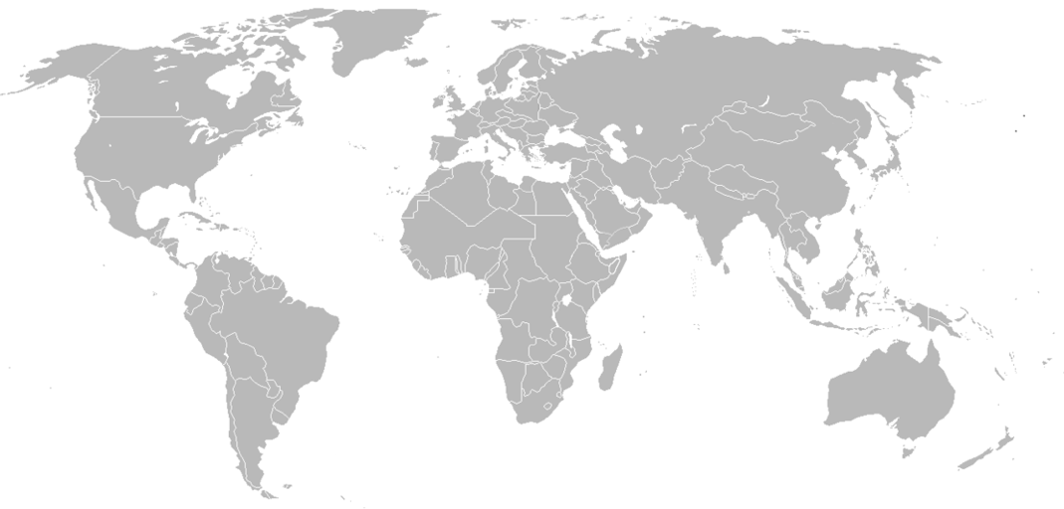
Major Business
Design Service
Turnkey Service
Channel Service
High Speed Domain Expertise
Cost-Effective Solution
Global Sales Outlets
FAE Support Team
Module Design Service
Customized Supply Chain
One-Stop-Shop
Low Power Technique
MP Experience of MEGA Design
Notes:
Design Service:
Special hardening skills and experienced on CPU/GPU/VPU to fulfill projects across Server, Tablet, IP Camera, STB, DVR and more.
Production proven records since 2007 on MSMV low power optimization with multi-Supply/Vdd/Vt and ICG, PMK, MBFF cells.
Silicon proven hierarchical flow for both top-down / bottom-up and 50M+ gate SoC design production proven records since 2012.
Turnkey Service:
提供最佳綜合成本效益解決方案
客製化供應鏈
一站式從晶片後段設計到量產後勤服務
Channel Service
全球銷售渠道
自有FAE Support Team
提供模組化設計服務

Slide 5

Overview
700+
90%+
SoC Projects
5/3nm
Socle Technology Corporation
Successful ASIC Projects
Advanced Project
23years
12+
30+
2B+
Chips Delivered
World's leading-edge provider
of SoC design and implementation services
Foundry Partners
Semiconductor Vendors
20+
15+
20K+
Product Lines
Global
Sales Outlets
Global Customers
Notes:
最上面三格為Design Service:
500+: 20年做了超過500個以上專案；2001~2017每年約20~30個案子 (大都2個人一組、1個月T/O)，2018之後接較多大Scale的SoC Project，每年專案數才逐漸減少；平均每個月T/O兩個案子
90%+: 剩下10% 大部分為IP Harden Project
7nm: 目前最先進的專案為7nm AI Server Accelator
中間三格為Turnkey:
7+: 主要合作7家晶圓廠
30+:超過30家半導體相關的供應商 (測試、封裝等等)
2B+: 出貨超過20億顆晶片
底下三格為Channel Service
20+: 目前通路銷售20種以上的產品線
15+: 全球15個以上的銷售通路
20K+: 超過兩萬家客戶

Slide 6
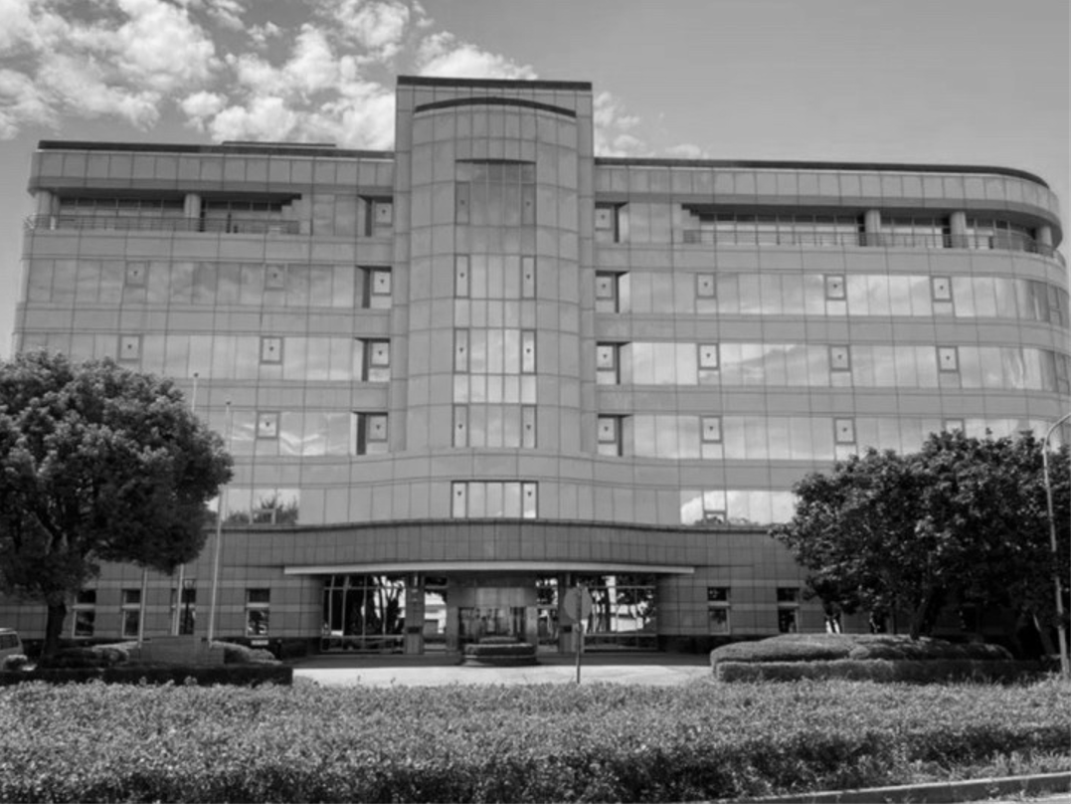
Milestones
2001
ISO9001 Certificated
ARM Design Center
2010
Foxconn WW IC Design Service Center
2020
GF Platinum Channel Partner
2005
2014
2022
WW 1st RTL-to-Silicon Design Service Company
GF WW IC Design Service Center
ISO 26262 Certificated
Top 3 IC Fabless Partner
Notes:
2001年為全球第一家提供RTL-to-Silicon服務，後續成為MIPS及ARM認證及授權的設計中心，並在2008年的到ISO9001品質管理認證
2009年GF入股後成為GF 設計服務中心，正如同台積之於創意、聯電之於智原，當時GF就尋找虹晶，並在2012年完成GF第一顆以A9為設計基礎的28 nm 專案T/O
2014年鴻海收購後加入鴻海集團，以及在2016年夏普加入鴻海後，鴻海成立S-Group；虹晶則為鴻海科技集團在半導體產業拓展版圖之樞紐，包含夏普晶圓事業及元件海外銷售通路、晶片設計中心、技術支援中心等。而後在2018年協助設計及生產全球第一顆8K AI TV SoC。在2019年協助客戶完成全中國第一顆高階自動駕駛晶片後，在2020年通過ISO26262道路車輛功能安全認證以及完成第一顆7 nm AI晶片。

Slide 7
Service Overview: ONE STOP SHOPPING SERVICE
Design
Product
Sales
Design Implementation &
Verification
Sales Channel
Production
FE Design
BE Design
GDSII
Wafer
Chip
Module
Channel
Design Service: SoC-ImP®
Turnkey Service
Channel Service
RTL/Netlist-to-GDSII
GDSII-to-Chip
FE / IP Integration
Module Design/MFG
Global Sales Channel
MP T/O
Assembly
IP/Block Hardening
Shuttle T/O
CP/FT
Service Interface Levels
Copyright© Socle Technology Corp

Slide 8


Quality System Certification
ISO 9001: 2015
ISO 26262: 2020
Notes:
Server, IoT, Automotive, Multimedia, ASIC

Slide 9
Design Service : SoC - ImP®

Slide 10

Service Overview: ONE STOP SHOPPING SERVICE
Design
Product
Sales
Design Implementation &
Verification
Sales Channel
Production
FE Design
BE Design
GDSII
Wafer
Chip
Module
Channel
Design Service: SoC-ImP®
Turnkey Service
Channel Service
RTL/Netlist-to-GDSII
GDSII-to-Chip
FE / IP Integration
Module Design/MFG
Global Sales Channel
MP T/O
Assembly
IP/Block Hardening
Shuttle T/O
CP/FT
Service Interface Levels
Copyright© Socle Technology Corp

Slide 11
SoC-ImP®：State of Art Solutions for SoC
Over 700 Silicon Proven; from 250 nm to 5 nm
Continuous Upgraded
Predictable
Controllable
Fast TAT with Quality
Project
Management
System
Script-Based
Flow
SoC-ImP®
SoC-ImP®
Domain
Expertise
State of Art
Technique
Special Hardening Skills on CPU/GPU/VPU
Proven on Tablet, IP Camera, STB, DVR, AP, AI…
Low Power Technique
Smart Placer
Up to 5 nm Design Flow
State of Art Solutions for SoC
Notes:
Script-Based Flow: 從250nm 到７nm所有業界規範、Methodology建置在SoC-ImP，包含DFT、Timing Closure、Timing Analysis、Low Power設計規範/方法
SoC-ImP與Project Management System連結
Low-Power Technique: 業界制定的Low Power設計規範，透過SoC-ImP，將EDA Tool所提供的Low Power Solution (CPF or UPF)整合至設計中；採納設計規範後能優化DVFS設計、平均漏電能優化為1/10、節省20%動態功耗
Domain Expertise: 將過往做過專案的Know-How也一併整合進SoC-ImP Flow中；譬如特殊Hardening技巧，並在各式各樣的應用產品中得到驗證，如平板、IP Cam、機上盒、監控主機、各類AP、AI處理器
*動態電壓調節（英語：dynamic voltage scaling）是計算機系統結構中的一種電源管理技術，它可以根據處理器實時的使用狀況，提高或降低電源電壓。由於電路的功耗與電源電壓存在平方的關係，因此在系統閒置或低速運行時，降低電源電壓可以大大降低電路的功耗。

Slide 12







SoC-ImP®：Core Technology and Data Flow
SoC Design Implementation Interface
Process Management & Design Management
SoC Design Methodology & Flow Development Interface
Design Constraints
Capture & Generator
Methodology & Flow
Developing
Doc DB
Design Constrain DB
Design Process
Developing
Script Generator
Script DB
Design Team
(Customer)
Flow & CAD
Team
(Socle)
Working Script
Lib & SIP DB
EDA Tools
Design DB
Result Reports

Slide 13
SoC-ImP®：Technology Roadmap
Major Tech
TSMC 12/16nm
FinFET Design
Flow Development
TSMC 7nm
FinFET Design
Flow Development
TSMC 5nm
FinFET Design
Flow Development
Version &
Schedule
SoC-ImP®
2020.12
SoC-ImP®
2022.12
SoC-ImP®
2023.2H (E)
Process Node
28/22/16/12 nm
+ 7/6 nm
+5/4 nm
Technology
Structured ASIC
Integrated with PKG
SoC-ImP® Express
RTL Prototype
TC/DFT-Diagnosis/Power/ DFM/DFY
Reliability: Dynamic IR/EM/ closure with SI/TC
Power:Multi-VDD
Structured ASIC
Integrated with PKG
SoC-ImP® Express
RTL Prototype
TC/DFT-Diagnosis/Power/ DFM/DFY
Reliability: Dynamic IR/EM/ closure with SI/TC
Power:Multi-VDD
Structured ASIC
Integrated with PKG
SoC-ImP® Express
RTL Prototype
Hierarchical Imp. flow
TC/DFT-Diagnosis/Power/ DFM/DFY
Reliability: Dynamic IR/EM/ closure with SI/TC
Power:Multi-VDD

Slide 14
SoC-ImP®：Design Flow and Golden EDA Solutions
RTL to Netlist Solution
Aggressive Synthesis
Coding Purification
Constraint Check
Top Down two pass hierarchical flow
Topographic Synthesis
Synopsys
DC-NXT
SpyGlass Lint
SpyGlass Constraints
Power Compiler
TestMAX DFT / ATPG
PrimePower
Formality
VCS
Cadence
Conformal Low Power
Xcelium
DFT Solution
DFT
DC/AC Scan/ATPG
MBIST/MBISR
ROM BIST w/ ROM code change
Mentor
Tessent MBIST
Low Power Solution
Low Power Methodology
Clock Gating (ICG)
Vt Swapping power optimization
Physical Design
APR
Solution
Hierarchical APR Implementation
Floorplaning
Power Network Check
Placement
CTS (CCOPT)
Routing
MMMC Timing Optimization
Cadence
Innovus (7 nm and above)
Quantus
Voltus
Synopsys
Star-RC Ultra
Timing Closured Solution
STA
OCV + MMMC Analysis
Sign-Off Timing ECO and Leakage Opt. …
Synopsys
PrimeTime ADVP
Tweaker
Power Integrity
& Reliability
Sign Off Solution
PNA
PGV library generation
Power analysis & power network analysis
Static and Dynamic IR/EM Analysis
Signal EM analysis
Cadence
Voltus
Physical Verification & DFM
Sign Off Solution
DFM
ESD / Latch Up check
DRC/LVS (MP)
DFM MCD rule check,
SMART Dummy Fill ….
Mentor
Clibre PERC
Calibre DRC/LVS
Calibre MP
Calibre YE
Notes:
SoC-ImP B/E Service Flow and related EDA tool for each phase
多年以來累積的經驗
SoC-ImP能擷取並整合各家EDA Tool優勢，來對於設計做出最佳方案 (EX: Synopsys DFT + Mentor MBIST)

Slide 15
SoC-ImP®：Implementation Methodology
Lower Power-MSMV Total Solution (CCS/ECSM)
Physical Library
Check-In
Aggressive Synthesis
Conformal Equivalent Check with CPF
Synthesis & Opt.
MSMV Aware
Floorplan / powerplan
B/CTS
Low Power Opt. -- ICG
MSMV STA
MSMV Aware Scan & BIST & BSD
Floorplan / Powerplan
Refinement
MSMV Power Analysis
Power logic insertion
Power Network Check
Physical Synthesis
Static /Dynamic
PNA
MSMV Aware placement
MSMV Aware Detail Route
MSMV CTS
Power Opt.(multi-Vt)
A/CTS
MSMV Aware Scan Re-ordering
Xtalk Prevention
MSMV Power
Analysis
MSMV/DFM Aware Detail Route
MSMV
STA (OCV)
Post Place Opt. / Timing Analysis
Routing Opt.
Post Route Opt.
Ramp-up Analysis
RC Extraction
CTS Plan
De-cap Opt.
Xtalk Fix (Noise / Timing)
Physical Verification
DFT/MBIST/BSD Timing Fix
MSMV LVS
MSMV LVS
DRC
Antenna
GDSII
Sign-off
Xtalk
Sign-off
Power
Sign-off
MSMV Aware STA
Sign-off
MSMV Aware IR
Sign-off
MSMV Aware DFT
Sign-off
DFM
Notes:
SoC-ImP B/E Service Flow and related EDA tool for each phase
多年以來累積的經驗
SoC-ImP能擷取並整合各家EDA Tool優勢，來對於設計做出最佳方案 (EX: Synopsys DFT + Mentor MBIST)

Slide 16


Proven Case #1 (2018)
WW 1st 8K TV SoC
28nm
TSMC HPC+
200M
Gate Counts
150Ku
Shipped in 1st yr
Multi-Side
Partners
Notes:
Multi-Side: SHARP (JP), Socle (TW), and FE Design Partner (TW)
Imp TAT = 3M, after design fixed
1-Cut MP; 量產第一年內出貨超過15萬顆

Slide 17
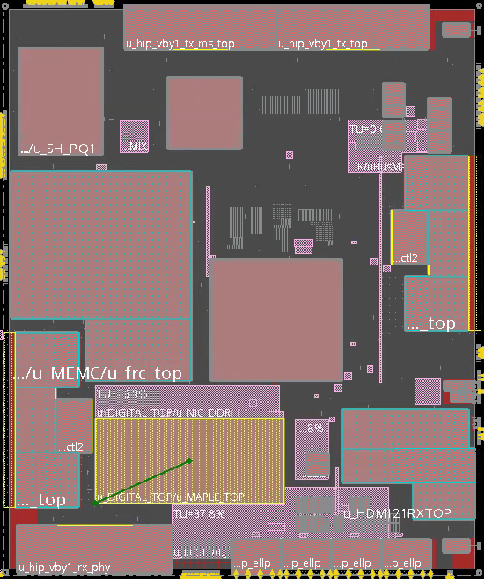
Proven Case #1 (2018) WW 1st 8K TV SoC
Project Scope
IPs License, Hardening and Verification
Physical Design Including F/C Design and DFT/MBIST/MBISR Insertion
Turnkey Services
Chip Features
Application : 8K TV SoC
Technology: tsmc 28 nm HPC+
Main Clock Freq: 600MHz
Bus Clock Freq: 400MHz
Critical IPs: MEMC, DDR4 PHY/CTRL (2.4GHz), HDMI2.0/HDMI2.1, VBO
Gate Count: ~200M (Top: 90M)
Size: 14200 um x 17000 um
PKG Type: FCBGA
Challenges
Highlights
Bottom-up Hierarchical Implementation Approach
Large Chip Size with Aggressive TAT
Oversea Project Management
Tape-out in 3 Months after Design Freeze
1st Cut Work

Slide 18
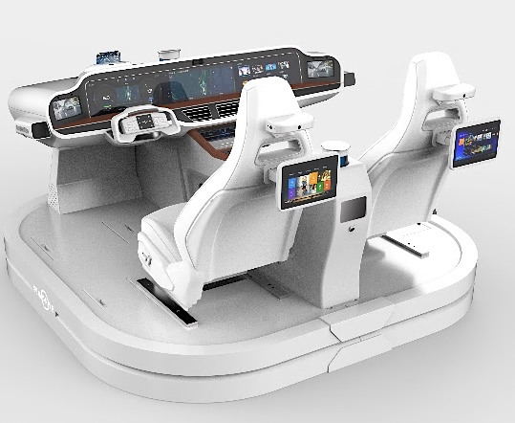

Proven Case #2 (2019)
Automotive AP (ADAS)
16nm
TSMC 16FFC
37M
Gate Counts
6xPU
Harden Cores
AEC-Q100 Qualified
Notes:
原NXP車用IC團隊新創公司 (芯馳)
全中國第一顆高階車用IC，我們負責關鍵行車輔助及自動駕駛AI晶片6個 xPU Harden (最困難的部分)
客戶端IC已經 Qual過AEC-Q100 Grade 0(-40~+150) , 175度
客戶端及我們都已認證過ISO26262車用電子品管規範
客戶預計2021年開始量產，目前已多家Tier 1車廠接洽中

Slide 19
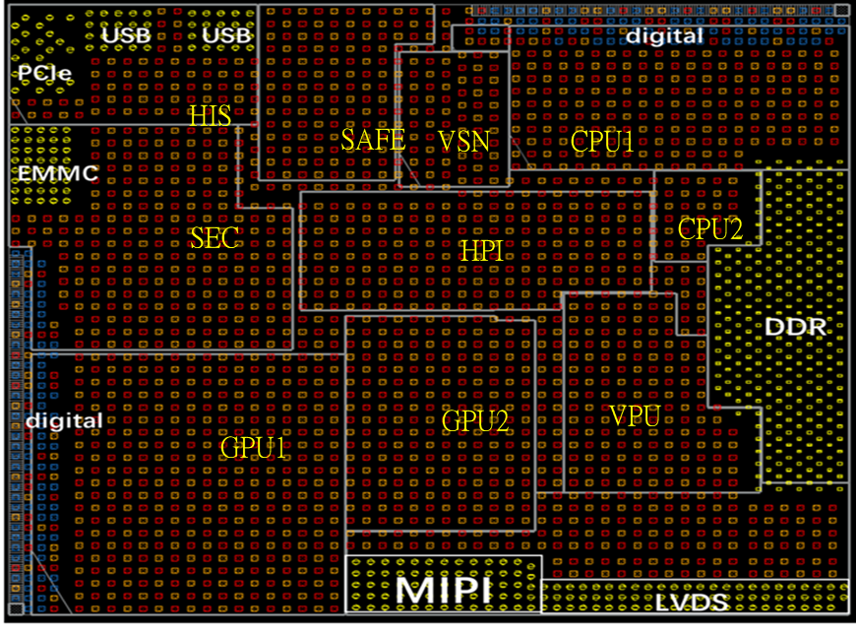
Proven Case #2 (2019)_16 nm FFC xPUs Harden Project
Project Scope
CPU1
NPU
IP Hardening and Verification
Chip Features
CPU2
Application : Automotive AP processor
Technology: tsmc 16 nm FFC
Major IPs: CPUx2, GPUx2, VPU, VSN (NPU)
Harden Block Gate Count, Area and Performance:
VPU
GPU2
GPU1
Harden Block | Gate Count | Size (mm²) | Target Freq | Actual Freq @WC
CPU1 | 6.4M | 7.83 | 2GHz | 1.7GHz
CPU2 | 1.13M | 1.14 | 1.5GHz | 1.5GHz
GPU1 | 12.54M | 11.04 | 625MHz | 625MHz
GPU2 | 6.3M | 5.45 | 625MHz | 625MHz
VPU | 8.37M | 4.23 | 666MHz | 666MHz
NPU | 2.33M | 2.14 | 750MHz | 750MHz
Challenges
High Target Frequency (Target Freq: 2GHz)
Competitive Core Size Requirement for each Harden Block
Highlights
CPU1 can run up to 1.7GHz @ WC

Slide 20

Proven Case #3 (2020)
Edge AI Accelerator IP
7nm
TSMC 7 FFC
70M
Gate Counts
18 TOPS/W
4.5X General
Unique AI ALU Harden
Notes:
Customer provide tile unit design and Socle implement a repeatable module
特殊AI Harden需求、使AI運算單元可擴充性/延伸性大增
搭配特殊IP Harden技巧，Prototype加速器效能達32 TOPS (效能約等於nVidia AI 平台最高規格Jetson AGX XAVIER系列)
Oppo MariSilicon X NPU adopted this IP Solution and loaded on Find X5

Slide 21
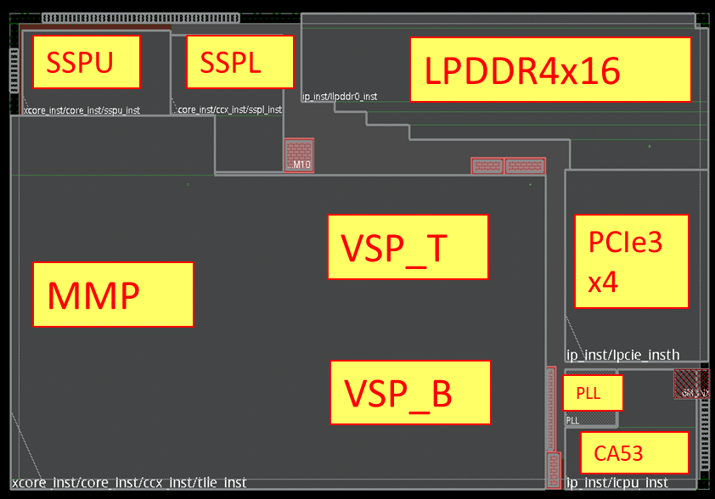
Proven Case #3 (2020)_1st Project with M Company
Project Scope
Physical Design Including IP Harden and DFT/MBIST Insertion
PI/SI Services for PKG Substrate and PCB Design
Chip Features
Application : AI-Coprocessor
Technology: TSMC N7FFC
Power Domain: 1
CPU clock frequency: A53 1 GHz @WC
Major IPs: CPU, PCIe-3, LPDDR4, PLL
BGA
Challenges
Highlights
High Target frequency need manual efforts during APR
Competitive core size to cause routing difficulty and need manual efforts during APR
CPU can run up to 1.0 GHz @ WC
Special ALU Design
Optimizer Flow than M-Company
Notes:
Customer provide tile unit design and Socle implement a repeatable module
特殊AI Harden需求、使AI運算單元可擴充性/延伸性大增
搭配特殊IP Harden技巧，Prototype加速器效能達32 TOPS (效能約等於nVidia AI 平台最高規格Jetson AGX XAVIER系列)
Oppo MariSilicon X NPU adopted this IP Solution and loaded on Find X5

Slide 22


Proven Case #4 (2021)
DDR5 for Data Center
12nm
TSMC 12 FFC
4.5M
Gate Counts
3.2GHz
Max Clock Freq
Low Power Design

Slide 23
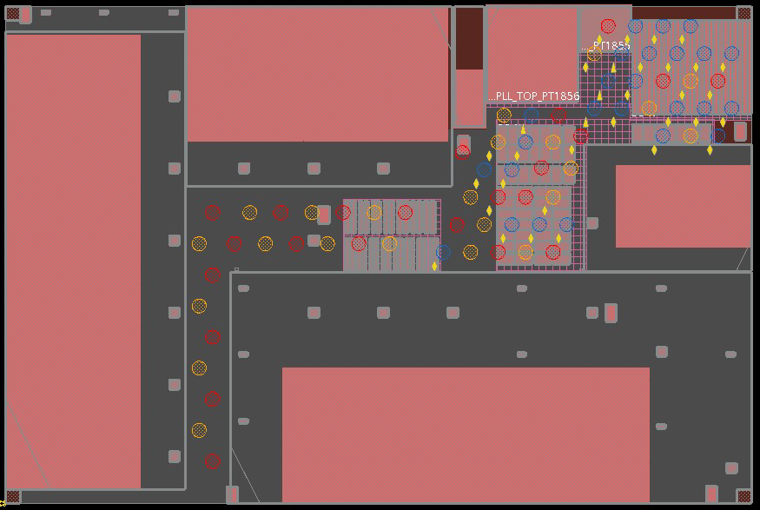
Proven Case #4 (2021)_12 nm DDR5 Controller Testchip
Project Scope
Physical Design
RDL Layout Support
Chip Features
Application : DDR5
Technology: TSMC N12FFC
Power Domain: 2
Max clock frequency: 3.2GHz @WC
Area: 3600um * 2400um
Challenges
High Target frequency need many manual efforts during timing closured
Competitive core size and low power solution implementation
Highlights
TSMC N12FFC DDR5 with low power solution project
Project from Top 3 Storage Controller Provider in the World

Slide 24
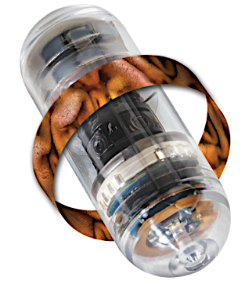
Proven Case #5 (2022)
Biomedical MCU
55nm
TSMC 55 LP
13%
Area Saving (vs. Previous Ver.)
8%
Power Lower (vs. Previous Ver.)
One-Stop-Shopping Service

Slide 25
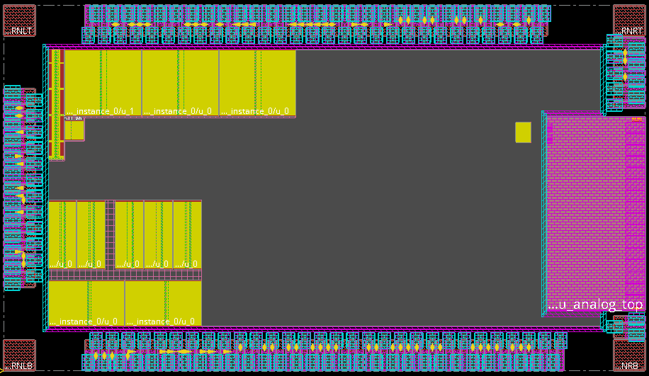
Proven Case #5 (2022)_55 nm Biomedical MCU
Project Scope
Physical Design
TK Service (Wafer, CP, and FT)
Chip Features
Application : Biomedical
Technology: TSMC 55LP
Clock Domain: 22
Max clock frequency: 40MHz @WC
Area: 3117um * 1776um
Challenges
Highlights
Competitive core size and low power solution implementation
Foundry porting project from GF 55nm to tsmc 55nm
Optimized area size up 13% reduce comparing to previous product

Slide 26
























Outstanding References
50+ global customers including Fortune 500 companies like NXP, Sharp, Renesas, Socionext, Foxconn, ……
Notes:
Server, IoT, Automotive, Multimedia, ASIC

Slide 27
Turnkey Service

Slide 28







Socle OSAT Engineering Service
Complete OSAT Engineering Services
Multi-OSAT Engineering Experience
Successful NPI and MP records
Package solutions
Testing solutions
100+ package NPI records
50+ testing NPI records
Success records and Experience:
Package
Big PKG Size & High Pin Count
Multi-Dies (Side by Side)
Multi-Dies (Stack)
Hybrid (Wire bond + Flip Chip)
Flip Chip (Solder Bump)
IoT SiP
Testing
High-speed digital, Power device, Mixed-signal & RF devices
Digital test pattern data rate up to 400 MHz / 800 Mbps
Scalable configurations for RF applications
Direct docking probe card & Fine pitch < 80um for Wafer Sorting
Leadframe PKG
QFN, QFP, ..
Pattern Conversion
Wire-bond BGA
TFGBA, PBGA, ..
Test Program Development
Flip Chip BGA
FC BGA, WLCSP, ..
Characterization
Sensor & Module
IoT SiP, RF, ..
Wafer Sorting/
Package Testing
Electrical & Thermal
Simulation
System Level testing

Slide 29
Turnkey flow GDS-to-Chip Phases
Foundry Phase
Assembly Phase
Testing Phase
TO Service (MPW/Full mask)
Die Info
Check
Ball Map
Assign
Netlist
Check
Function
Patterns
DFT/MBIST
Patterns
Wafer / Assy Info
Device list
check
Mask layer#
evaluation
FSR/MTF
check
Testing
Plan
Testing
Circuit
Tester Spec
IP merge
DRC review
Substrate
Design
Constraint Setting
Impedance Control
P/C
Design
LB
Design
Socket
Design
Change Kit
Design
D.O.E.
Product Engineering/
Yield Enhancement
DRC Check
Program
Develop
Corner Wafers
Character.
FA
Electrical
Analysis
Thermal
Analysis
Program
Debug
Pilot Run
Data Collect
ESD&L/U
Reliability test
Substrate O/S
Checking kit
Substrate
Manufacturing
Ready for
Production
Package O/S
Checking Kit
Auto Ball Mount Kit

Slide 30
G2C Phase Objectives & Deliverables
Foundry Phase
Assembly Phase
Testing Phase
Review DRC violations w/ customer and Foundry
Optimize design/process by D.O.E.
Support RDL bump design
Complete substrate design & tooling
Complete package assembly
Complete electrical & thermal analysis
Finish testing program
Complete testing tool design
Complete character. report
Design Database
Process/IP data
FSR/MTF
Device list
Stream out log
DRC/DFT report
Split table
Wafer plan
Report
DRC review result
WAT
Design Database
Substrate Layout File
Bonding Diagram
Package Outline Drawing
Trace Length Table
Marking Specification
Report
SI/PI Simulation Report
Thermal Simulation Report
Design Database
test plan, patterns, circuit
wafer, assembly info,
Implementation Result
Testing program
CP stage: P/C
FT stage: LB, socket, change kit
Report
Test sign-off report

Slide 31
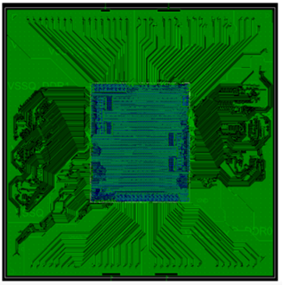
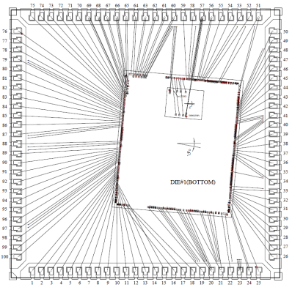
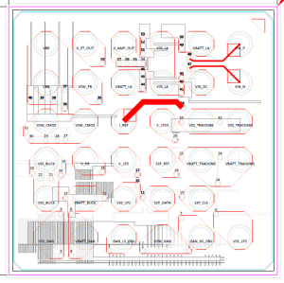
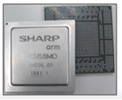
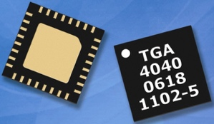

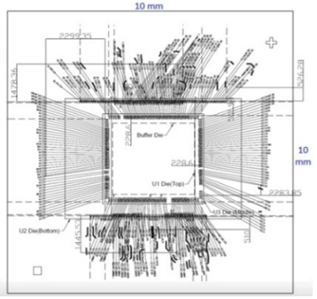
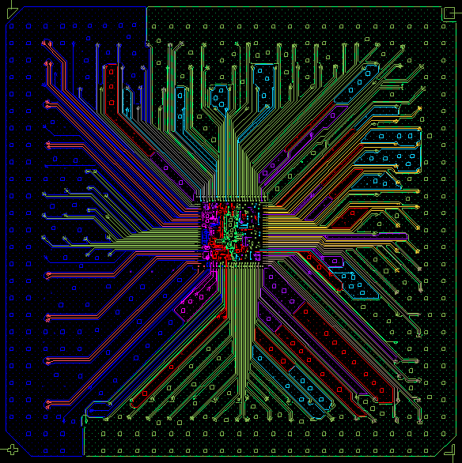
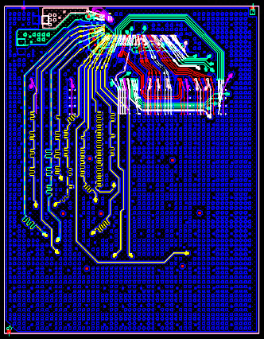
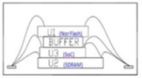

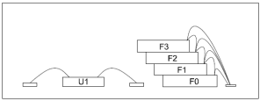
Package Design Experience with Overseas Customers
Japan customer
Korea customer
Singapore customer
Application: 8K TV
PKG Type: FCLBGA
Die Count: 1
OSAT: SPIL
Application: Touch IC
PKG Type: QFN
Die Count: 2
OSAT: ASE
Application: RF PA
PKG Type: QFN
Die Count: 2
OSAT: ASE
Singapore customer
India customer
Hong Kong customer
Application: WiFi SD
PKG Type: TFBGA
Die Count: 3
OSAT: ASE
Application: IP Verif.
PKG Type: FCCSP
Die Count: 1
OSAT: Amkor
Application: eMMC
PKG Type: TFBGA
Die Count: 5
OSAT: SPIL

Slide 32
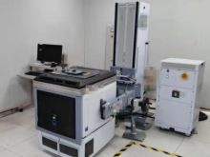
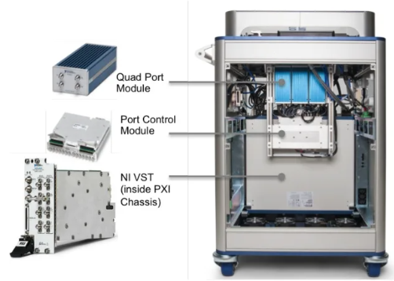
Testing Development Recently Developed Cases
Japan customer
Korea customer
Taiwan customer
Device : SoC for 8K TV
Test platform : J750EX
Project : CP/ FT
Device : Touch IC for the capacitive touch screen
Test platform : J750EX
Project : CP / FT
Device : RFID transceiver for IoT
Test platform : NI-STS
Project : FT

Slide 33
Channel Service

Slide 34




World Wide Sales Channel：Locations and Values
Representing Foxconn Group Brands at several regions
Plenty connections, sales routes around the world
Experienced FAE in consumer electronics, such as Air purifier, Camera, Distance ranging, Robot…etc.
Leveraging engineering resource in Foxconn group for building up sensor modules
Global online Distributors
Socle Reps / Distributors
Socle Sales Office
Notes:
Socle藉由銷售Sharp電子原器件產品,在各個區域建立起相關的銷售渠道以及當地的銷售人員. 在銷售鴻海集團產品的同時,也在世界各地尋找有競爭力的產品,試圖帶回集團做出貢獻
Socle有建立起FAE團隊,專精於消費性產品。
Socle同時也可利用鴻海集團的工程資源, 能將傳給器組成模組, 或者是將模組在更進一步組成系統的能力。
負責區域: 中國、美國 、東南亞、印度
自有Office:上海、杭州、深圳、台灣、加拿大

Slide 35
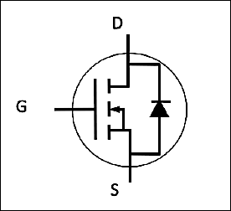




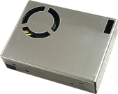



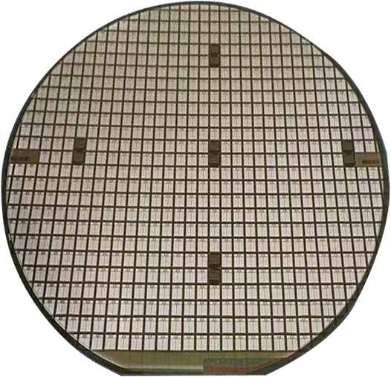
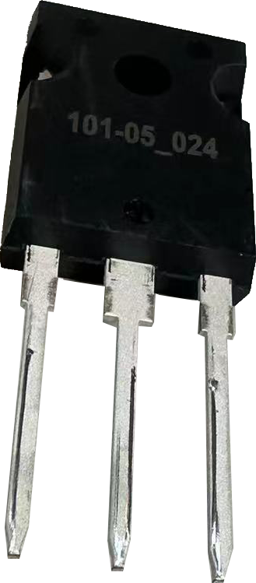






Product Line
Sensors
Wi-Fi 4/5/6 (+BT) Wireless Module
Power Isolation
Power Semiconductor
Photo coupler
Photo-interrupter
PM2.5 sensor
Gate Driver
Distance Measurement Sensor
Laser
SiC MOSFET
TOF sensor & module
MEMS Mic
Laser Diode
Sensing
Computing
Communication
Control
Notes:
To247 想個圖 一個晶圓

Slide 36
Power Semiconductor

Slide 37

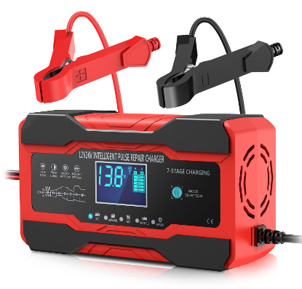
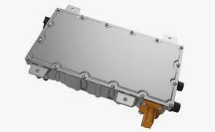
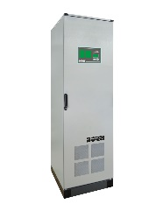


Power Semiconductor – SiC MOSFET
Applications
Battery Chargers
DC/DC converters
Industrial Inverter
Features
Item | Parameter
Drain-Source Breakdown Voltage | 1200 | 1700V
RDS | 12, 16, 20, 40, 70mohm | 40mohm, 1ohm, 50ohm
Guaranteed performance over temperature | 25°C ~ +175°C.

Slide 38
Power Semiconductor – SiC MOSFET Product List
Emerald series | Gen 1 |  |  |  |  | Gen 2
 | 1200V
 | 12mohm | 16mohm | 20mohm | 40mohm | 70mohm | 16mohm
Drain-Source Breakdown Voltage (BV) | 1200V | 1200V | 1200V | 1200V | 1200V | 1200V
Gate-source threshold voltage (Vth) | 2.9V | 2.9V | 2.9V | 2.9V | 2.9V | 3V
Drain-source on-state resistance (Ron) | 12mohm | 16mohm | 20mohm | 40mohm | 70mohm | 16mohm
Continuous DC drain current (Id) | 125A | 105A | 85A | 55A | 35A | 100A
Gate-to-drain charge (Qgd) | 95nc | 69nc | 55nc | 35nc | 27nc | 94nc
Rutile series Gen 2 | 1200V
 | 12mohm | 16mohm | 20mohm | 40mohm | 70mohm
Drain-Source Breakdown Voltage (BV) | 1200V | 1200V | 1200V | 1200V | 1200V
Gate-source threshold voltage (Vth) | 2.9V | 2.9V | 2.9V | 2.9V | 2.9V
Drain-source on-state resistance (Ron) | 12mohm | 16mohm | 20mohm | 40mohm | 70mohm
Continuous DC drain current (Id) | 135A | 110A | 90A | 55A | 35A
Gate-to-drain charge (Qgd) | 94nc | 70nc | 55nc | 28nc | 16nc

Slide 39
Power Isolation

Slide 40
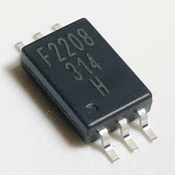
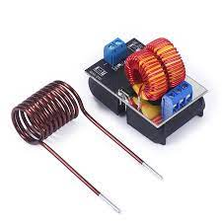
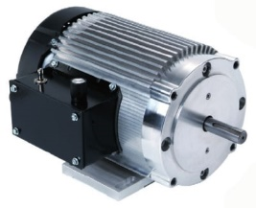



Power Isolation - Gate Driver Photocoupler
Applications
AC brushless
Induction Heating
Industrial Inverter
Features
Anode
V_{CC}
Item | Parameter
Maximum peak output current | 0.8A, 1A, 3A, 4A
Rail-to-rail output voltage | Yes
Maximum propagation delay | 110 ns
Under Voltage Lock-Out protection (UVLO) with hysteresis | Yes
Wide operating range | 10 to 30 Volts (VCC)
Guaranteed performance over temperature | -40°C ~ +110°C.
Safety approval | UL, VDE, CQC
V_{O}
Cathode
V_{SS}

Slide 41
Power Isolation - Gate Driver Photocoupler
Selection Table
Part number | Package | Status | Peak Output Current (A) | V_{iso} (Vrms) | V_{CC} (V) | T_{PLH}/T_{PHL} (Max) | T_{OPR} (℃)
FSS-5701P/W-T1V | LSOP6 | MP | 0.8 | 5000 | 10 ~ 30 | 110ns | -40 ~ 110
FSS-314P/W-T1V | LSOP6 | MP | 1 | 5000 | 10 ~ 30 | 110ns | -40 ~ 110
FSS-341P/W-T1V | LSOP6 | MP | 3 | 5000 | 15 ~ 30 | 110ns | -40 ~ 110
FSS-343P/W-T1V | LSOP6 | MP | 4 | 5000 | 15 ~ 30 | 110ns | -40 ~ 110
Cross Reference
Gate Driver
Part number | Package | Feature | BROADCOM | TOSHIBA
FSS-5701P/W-T1V | LSOP6 | 0.8A | --- | ---
FSS-314P/W-T1V | LSOP6 | 1A | ACPL-P314 | TLP5701
FSS-341P/W-T1V | LSOP6 | 3A | ACPL-P341 | TLP5754
FSS-343P/W-T1V | LSOP6 | 4A | ACPL-P343 | TLP5754

Slide 42
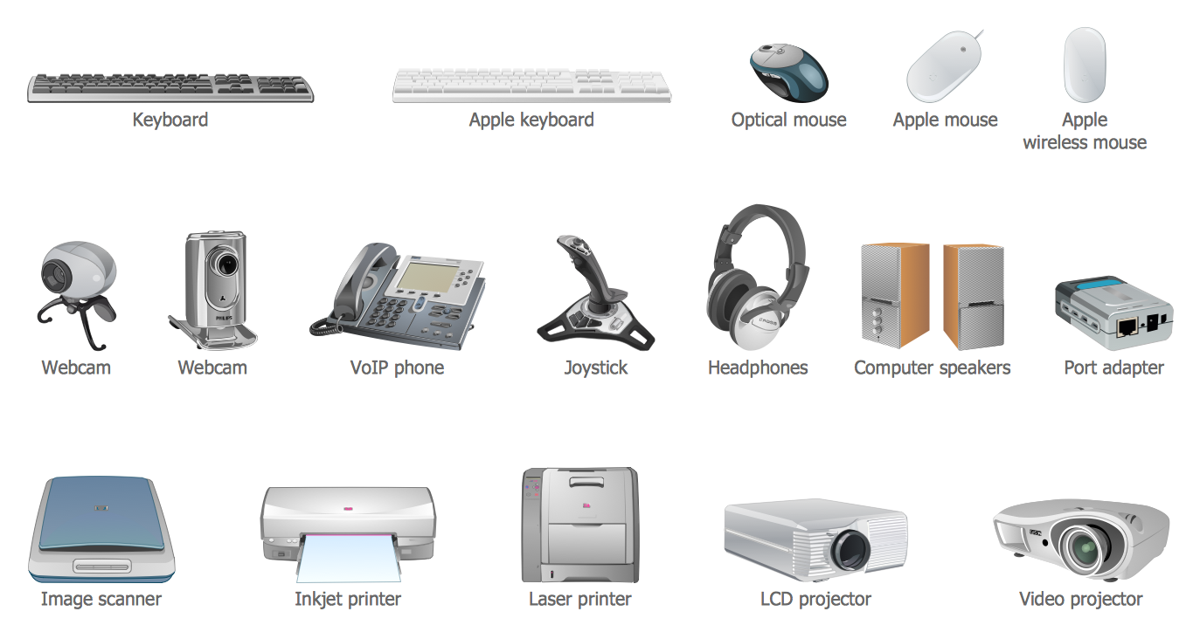
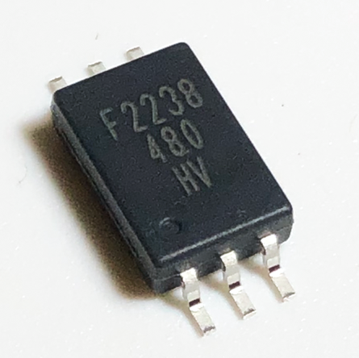
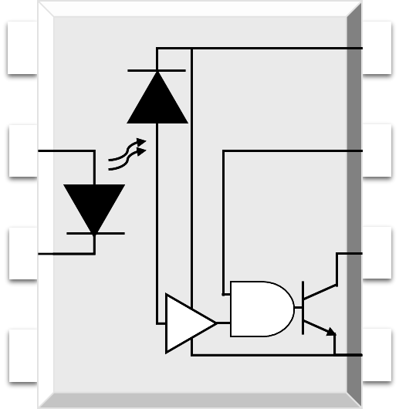
Photocoupler - High Speed
Applications
  Ground loop elimination
  LSTTL to TTL
  LSTTL or CMOS
  Line receiver
  data transmission
  Switching power supply
  Pulse transformer replacement
  Computer peripheral interface
NC 1
8 V_{CC}
Features
Anode 2
7 V_{E}
Item | Parameter
Switching Speed | 1M & 10M bit/s Max
High isolation | 5000 VRMS
DC input with logic gate output | Yes
Operating temperature range | - 55 °C to 100 °C
MSL | Class 1
Cathode 3
6 V_{O}
NC 4
5 GND

Slide 43

Photocoupler - High Speed
Selection Table
Part number | Package | Status | Feature | V_{iso} (Vrms) | V_{CC} (V) | T_{PLH}/T_{PHL} (Max) | T_{OPR} (℃)
FSS-480P/W-T1V | LSOP6 | MP | IPM, Positive output | 5000 | 35 | 250ns | -55~110
FSS-481P/W-T1V | LSOP6 | MP | IPM, Negative output | 5000 | 35 | 250ns | -55~110
FSS-611P/W-T1V | LSOP6 | MP | 10M | 5000 | 3.3/5 | 75ns | -40~110
FSS-50LP/W-T1V | LSOP6 | MP | 1M | 5000 | 3.3/5 | 75ns | -40~110
Cross Reference
High Speed
Part number | Package | Feature | BROADCOM | TOSHIBA
FSS-480P/W-T1V | LSOP6 | IPM, Positive output | ACPL-P480 | TLP2710
FSS-481P/W-T1V | LSOP6 | IPM, Negative output | ACPL-P481 | TLP2710
FSS-611P/W-T1V | LSOP6 | 10M High Speed | ACPL-P483 | TLP2748
FSS-50LP/W-T1V | LSOP6 | 1M High Speed | ACPL-W50L | TLP2719 (LF4)

Slide 44
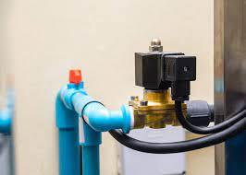
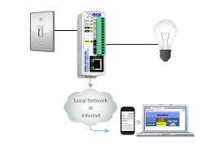
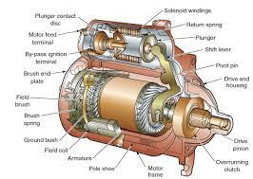

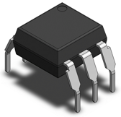
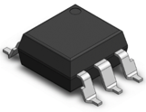
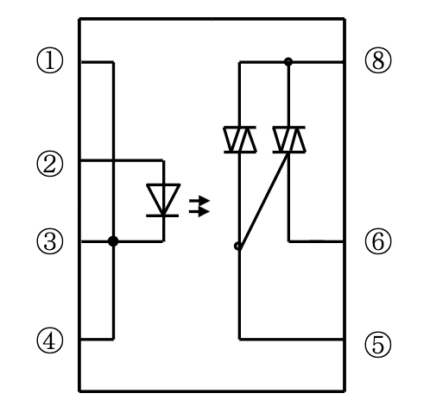
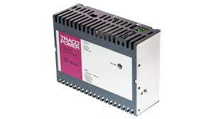
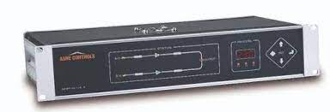
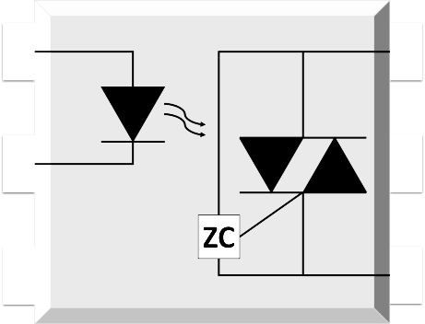
Photocoupler - Phototriac
Applications
Solenoid / valve controls
Lighting controls
Motor controls
Temperature controls
Anode 1
6 Terminal
Static AC power switches
Solid state relays
Interfacing microprocessors to 115 to 240V AC peripherals
Cathode 2
5 Substrate
NC 3
4 Terminal
Features
Item | Parameter
High isolation | 5000 VRMS
DC input with zero-cross / random-phase photo triac output | v
Operating temperature range | - 40 °C to 100 °C
REACH & RoHS compliance | v
MSL | Class 1
Safety approval | UL, VDE, and CQC
Notes:
Description
The 305X and 306X series combine an AlGaAs infrared emitting diode as the emitter which is optically coupled to a monolithic silicon random-phase photo triac in a plastic DIP6 package with different lead forming options.

Slide 45


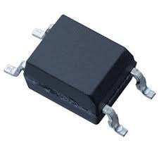
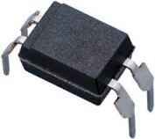
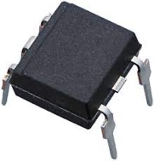
Photocoupler - Phototriac
Selection Table
Part number | Package | Status | Feature | V_{iso} (Vrms) | V_{CC} (V) | T_{PLH}/T_{PHL} (Max) | T_{OPR} (℃)
FSS-305XP/W-T1V | DIP6 | MP | Z.C | 5000 | 15,10,5 | 600 | 55~110
FSS-306XP/W-T1V | DIP6 | MP | R.P | 5000 | 15,10,5 | 600 | 55~110
Part number | Package | Applied voltage | Feature |  | ON-state current
S2S3A00F / S2S5A00F / S2S5FA0F | Mini-flat 4-pin | AC 200 V lines | 200 V lines, compact |  | 0.05 A
S2S4A00F | Mini-flat 4-pin | AC 200 V lines | 200 V lines, compact | Built-in zero-cross circuit | 0.1 A
PC3SH11YFZAH / PC3SH13YFZAH | DIP4 | AC 200 V lines | Reinforced isolation |  | 0.1 A
PC3SH21YFZBH | DIP4 | AC 200 V lines | Reinforced isolation | Built-in zero-cross circuit | 0.1 A
PC3SD12NTZAH / PC3SD11NTZBH / PC3SD11NTZCH | DIP4 | AC 200 V lines | General purpose |  | 0.1 A
PC3SD21NTZAH / PC3SD21NTZBH / PC3SD21NTZDH | DIP6 | AC 200 V lines | Reinforced isolation | Built-in zero-cross circuit | 0.1 A
PC3SF11YVZAH / PC3SF11YVZBH | DIP6 | AC 200 V lines | Reinforced isolation |  | 0.1 A
PC3SF21YVZAH / PC3SF21YVZBH | DIP6 | AC 200 V lines | General purpose | Built-in zero-cross circuit | 0.1 A
PC4SD11NTZCH | DIP6 | AC 200 V lines | General purpose |  | 0.1 A
PC4SD21NTZCH / PC4SD21NTZDH | DIP6 | AC 200 V lines | Reinforced isolation | Built-in zero-cross circuit | 0.1 A
PC4SF11YTZBH | DIP6 | AC 200 V lines | Reinforced isolation |  | 0.1 A
PC4SF21YVZBH / PC4SF21YWPSH | DIP6 | AC 200 V lines |  | Built-in zero-cross circuit | 0.1 A

Slide 46

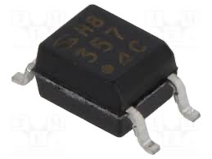
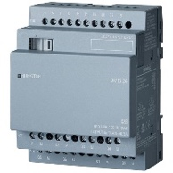
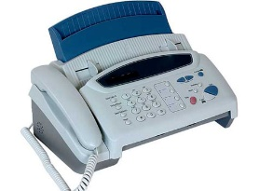
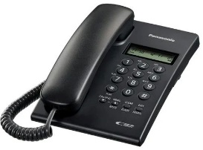







Power Isolation - Photocoupler
Applications
Programmable controller
Facsimiles
Telephones
Garage door opener
Process control
Features
Item | Parameter
Double transfer mold package | DIP4, DIP8
High collector-emitter voltage | VCEO : 80V
High isolation voltage between input and output | 5 kV
Current transfer ratio | 50%
Safety approval | UL, VDE, CQC
Notes:
＊北美賣哪些大客人 換

Slide 47


Power Isolation - Photocoupler - Transistor output
Selection Table
Part number | Package | Output type | Feature
PC357NJ0000F / PC451J00000F | Mini-flat 4-pin | Single phototransistor | High collector-emitter voltage
PC367NJ0000F | Mini-flat 4-pin | Darlington phototransistor | AC input response | Low input current
PC354NJ0000F | Mini-flat 4-pin | Darlington phototransistor | AC input response
PC364NJ0000F | Mini-flat 4-pin | Darlington phototransistor | High sensitivity, High collector-emitter voltage | Low input current
PC355NJ0000F / PC452J00000F | Mini-flat 4-pin | Darlington phototransistor | High sensitivity, High collector-emitter voltage
PC365NJ0000F | Mini-flat 4-pin | Single phototransistor | General purpose | Low input current
PC3H7J00001H | Compact half pitch | Single phototransistor | General purpose
PC3HU7xYIP1B | Compact half pitch | Single phototransistor | AC input response | Reinforced insulation
PC3H71xNIP1H | Compact half pitch | Single phototransistor | AC input response | Low input current
PC3H3J00001H / PC3H4J00001H | Compact half pitch | Single phototransistor | AC input response
PC123XxYSZ1B | DIP4 | Single phototransistor | Reinforced insulation
PC1231xNSZ1B | DIP4 | Darlington phototransistor | High collector-emitter voltage | Low input current
PC817XxNSZ1B / PC851XNNSZ1H | DIP4 | Darlington phototransistor | High collector-emitter voltage
PC8171xNSZ1B | DIP4 | Darlington phototransistor | High sensitivity, High collector-emitter voltage | Low input current
PC852XNNSZ1H | DIP4 | Darlington phototransistor | High sensitivity, High collector-emitter voltage

Slide 48


Power Isolation - Photocoupler - OPIC output
Selection Table
Part number | Package | Output type | Feature
PC400J00000F / PC410LENIP0F | Mini-flat 5-pin | Digital output | General purpose, High response speed
PC457L0NIP0F | Mini-flat 5-pin | Analog/Digital output | High CMR
PC923LRNSZ0F | DIP8 | Built-in base amplifier | For inverter control | 1.5A output
PC925LENSZ0F | DIP8 | Built-in base amplifier | For inverter control | 2.5A output

Slide 49






Power Isolation - Solid State Relay
Applications
Heaters
Fans
Motors
White Goods
Features
Item | Parameter
Zero crossing functionary | VOX : MAX. 35V
High repetitive peak off-state voltage | VDRM : 400V ; 600V
High isolation voltage between input and output | Viso( rms ) : 4.0kV
Superior noise immunity | dV/dt : MIN. 100V/µs
Safety approval: | UL, VDE, CQC
Notes:
白電 替換

Slide 50


Power Isolation - Solid State Relay
Selection Table
Part number | Package | Applied voltage | Feature | ON-state current
PR31MA11NTZH | DIP6 | AC 200 V lines | General purpose | 0.06 A
PR32MA11NTZH | DIP6 | AC 200 V lines | General purpose | 0.15 A
PR33MF5 series / PR36MF5 series / PR39MF5 series / PR3BMF5 series | DIP8 | AC 200 V lines | General purpose | 0.3 / 0.6 / 0.9 / 1.2 A
PR36MF2 series / PR39MF2 series | DIP8 | AC 200 V lines | Built-in zero-cross circuit | 0.6 / 0.9 A

Slide 51
Laser Diode

Slide 52












Laser Diode - UV / Blue
Applications
biologically relevant
Life Sciences related
Particle Counter
VR/AR
Features
ø9 mm Can
ø5.6 mm Can
ø3.8 mm Can
Item-UV laser Diode | Parameter
Can Package | ø5.6 mm
Wavelength (nm) | 395 nm ~ 406 nm
Absolute Maximum rating Po (mW) | 1100 mW
Absolute Maximum rating Iop (mA) | 650 mA
Item-Blue laser Diode | Parameter
Can Package | ø3.8 mm , ø5.6 mm, ø9 mm
Wavelength (nm) | 435 nm ~ 487 nm
Absolute Maximum rating Po (mW) | 2000 mW
Absolute Maximum rating Iop (mA) | 4300 mA
ø3.3 mm Can
t1.8 mm Frame

Slide 53
Laser Diode - UV / Blue
Selection Table
Color | Part No. | Wavelength(Peak)Ap(nm) | Absolute maximum rating*1 Po(mW) | Absolute maximum rating*1 Iop(mA) | Absolute maximum rating*1 Top(C) | Po(mW) | Ith(mA) | lop(mA) | Vop(V) | ηd(mW/mA) | λp(nm) | Θ//(°) | Θ⊥(°) | FFP | Packaging | Monitor PD (Built-in:O)
UV | GH0393AA2G | 395 | 350 | - | O to +30 | 300 | 150 | 310 | 4.4 | 1.8 | 395 | 13 | 44 | *3 | ø5.6 | -
UV | GH0401FA2G | 405 | 155 | - | -10 to +75 | 150 | 40 | 130 | 5 | 1.7 | 405 | 9 | 19 | *2 | ø5.6 | -
UV | GH0401FA2K | 405 | 155 | - | -10 to +75 | 150 | 40 | 130 | 5 | 1.7 | 405 | 9 | 19 | *2 | ø5.6 | O
UV | GH04W10A2GC | 406 | 350 | - | 0 to +50 | 300 | 140 | 325 | 4.5 | 1.8 | 406 | 14 | 41 | *3 | ø5.6 | -
UV | GH0406AA2G | 405 | 700 | - | O to +30 | 600 | 120 | 420 | 4.4 | 2 | 405 | 16 | 38 | *3 | ø5.6 | -
UV | GH04V01A2G | 405 | 1100 | - | O to +30 | 1000 | 125 | 625 | 5 | 2 | 405 | 16 | 40 | *3 | ø5.6 | -
Blue | GH04C05W9G | 435 | - | 3600 | O to +45 | 5000 | 350 | 3100 | 4.5 | 1.8 | 435 | 9 | 47 | *3 | ø9.0 | -
Blue | GH04C05W9G | 435 | - | 3000 | 45 to +60 | 5000 | 350 | 3100 | 4.5 | 1.8 | 435 | 9 | 47 | *3 | ø9.0 | -
Blue | GH04C05V9G | 440 | - | 3500 | 0 to +35 | 5000 | 350 | 3100 | 4.6 | 1.9 | 440 | 10 | 47 | *3 | ø9.0 | -
Blue | GH04C03Z9G | 450 | - | 2800 | O to +60 | 3500 | 260 | 2100 | 4.4 | 1.85 | 450 | 9 | 47 | *3 | ø9.0 | -
Blue | GH04C06X9G | 450 | - | 4300 | O to +60 | 6000 | 300 | 4000 | 4.8 | 1.55 | 450 | 9 | 48 | *3 | ø9.0 | -
Blue | GH04580A2G | 450 | 85 | - | -10 to +70 | 80 | 22 | 84 | 5.1 | 1.3 | 450 | 10 | 24 | *2 | ø5.6 | -
Blue | GH04C01A2G | 450 | 1650 | - | -10 to +50 | 1600 | 200 | 1200 | 5 | 1.5 | 450 | 6.5 | 23 | *2 | ø5.6 | -
Blue | GH04C01B2G | 450 | 2000 | - | -10 to +50 | 1800 | 110 | 1100 | 4.1 | 1.8 | 450 | 7 | 26 | *2 | ø5.6 | -
Blue | GH04590A5G | 450 | 95 | - | -10 to +50 | 90 | 28 | 100 | 5.2 | 1.3 | 450 | 9 | 24 | *2 | ø3.8 | -
Blue | GH04850B2G | 487 | 55 | - | -10 to +60 | 50 | 40 | 105 | 6 | 0.8 | 487 | 8 | 23 | *2 | ø5.6 | -
ø9 mm Can
ø5.6 mm Can
ø3.3 mm Can
ø3.8 mm Can
t1.8 mm Frame

Slide 54




Laser Diode - Green / Red
Applications
Robotic pool cleaner
Projector
Laser Distance Meter
Measuring Device
Life Sciences related
Features
Item-Green laser Diode | Parameter
Can Package | ø3.8 mm , ø5.6 mm, ø9 mm, t1.8 mm
Wavelength (nm) | 515 nm ~ 520 nm
Absolute Maximum rating Po (mW) | 135 mW
Absolute Maximum rating Iop (mA) | 1650 mA
Item-Red laser Diode | Parameter
Can Package | ø3.3 mm ,ø3.8 mm, ø5.6 mm, ø9 mm, t1.8 mm
Wavelength (nm) | 638 nm ~ 660nm
Absolute Maximum rating Po (mW) | 1210 mW
Absolute Maximum rating Iop (mA) | 1600 mA
ø9 mm Can
ø5.6 mm Can
ø3.8 mm Can
ø3.3 mm Can
t1.8 mm Frame

Slide 55
Laser Diode - Green
Selection Table
Color | Part No. | Wavelength(Peak)Ap(nm) | Absolute maximum rating*1 Po(mW) | Absolute maximum rating*1 Iop(mA) | Absolute maximum rating*1 Top(C) | Po(mW) | Ith(mA) | lop(mA) | Vop(V) | ηd(mW/mA) | λp(nm) | Θ//(°) | Θ⊥(°) | FFP | Packaging | Monitor PD (Built-in:O)
Green | GH15230H8C | 515 | 35 | - | -10 to +60 | 30 | 30 | 90 | 7 | 0.5 | 515 | 7.5 | 22 | *2 | t1.8 | -
Green | GH05230H2KC | 520 | 35 | - | -10 to +60 | 30 | 25 | 70 | 6.5 | 0.65 | 520 | 7 | 22 | *2 | ø5.6 | O
Green | GH05250F2K | 520 | 55 | - | -10 to +60 | 50 | 40 | 100 | 5.9 | 0.7 | 520 | 7 | 22 | *2 | ø5.6 | O
Green | GH05280E2KC | 520 | 85 | - | -10 to +60 | 80 | 50 | 150 | 6.5 | 0.8 | 520 | 7 | 23 | *2 | ø5.6 | O
Green | GH05280E5K | 520 | 85 | - | -10 to +60 | 80 | 65 | 180 | 6.5 | 0.7 | 520 | 7 | 23 | *2 | ø3.8 | O
Green | GH0521DE2G | 520 | 135 | - | -10 to +60 | 130 | 70 | 270 | 6.7 | 0.65 | 520 | 8 | 22 | *2 | ø5.6 | -
Green | GH05290A5G | 520 | 95 | - | -10 to +50 | 90 | 60 | 185 | 6.75 | 0.7 | 520 | 7 | 23 | *2 | ø3.8 | -
Green | GH0521DE5G | 520 | 135 | - | -10 to +50 | 130 | 70 | 270 | 6.7 | 0.65 | 520 | 8 | 22 | *2 | ø3.8 | -
Green | GH0523AD2G | 520 | - | 850 | O to +60 | 300 | 100 | 500 | 5.2 | 0.75 | 520 | 7 | 23 | *2 | ø5.6 | -
Green | GH05C01A9G | 520 | - | 1400 | O to +60 | 600 | 180 | 1050 | 5.2 | 0.7 | 520 | 9 | 44 | *3 | ø9.0 | -
Green | GH05C01C9G | 520 | - | 2000 | O to +60 | 1000 | 250 | 1650 | 5.2 | 0.7 | 520 | 9 | 45 | *3 | ø9.0 | -
ø9 mm Can
ø5.6 mm Can
ø3.3 mm Can
ø3.8 mm Can
t1.8 mm Frame

Slide 56
Laser Diode - Red
Selection Table
Color | Part No. | Wavelength(Peak)Ap(nm) | Absolute maximum rating*1 Po(mW) | Absolute maximum rating*1 Iop(mA) | Absolute maximum rating*1 Top(C) | Po(mW) | Ith(mA) | lop(mA) | Vop(V) | ηd(mW/mA) | λp(nm) | Θ//(°) | Θ⊥(°) | FFP | Packaging | Monitor PD (Built-in:O)
Red | GH06C01A9G | 640 | 1210 | 1600 | O to +45 | 1200 | 350 | 1400 | 2.25 | 1.15 | 640 | 11 | 35 | *2 | ø9.0 | -
Red | GH06C02B9G | 640 | - | (tbd) | O to +55 | 2500 | 600 | 2800 | 2.4 | 1.1 | 639 | 15 | 70 | *3 | ø9.0 | -
Red | GH06330A2G | 638 | 30 | - | -10 to +60 | 30 | 30 | 50 | 2.3 | 1.4 | 638 | 7 | 16 | *2 | ø5.6 | -
Red | GH0631IA2GC | 638 | 185 | - | -10 to +60 | 180 | 70 | 215 | 2.55 | 1.15 | 638 | 8 | 13 | *2 | ø5.6 | -
Red | GH0632BA2GC | 638 | 210 | - | -10 to +60 | 200 | 55 | 230 | 2.65 | 1.15 | 639 | 8 | 15 | *2 | ø5.6 | -
Red | GH0637AA2G | 638 | 702 | - | -10 to +40 | 700 | 110 | 810 | 2.46 | 1 | 638 | 16 | 35 | *2 | ø5.6 | -
Red | GH0631CA5GC | 638 | 120 | - | -10 to +60 | 120 | 50 | 150 | 2.5 | 1.2 | 638 | 8 | 15 | *2 | ø3.8 | -
Red | GH0631IA5G | 638 | 185 | - | -10 to +60 | 150 | 60 | 190 | 2.5 | 1.15 | 638 | 7.5 | 15 | *2 | ø3.8 | -
Red | GH1631AA8C | 638 | 100 | - | -10 to +60 | 100 | 50 | 130 | 2.45 | 1.2 | 638 | 8 | 15 | *2 | t1.8 | -
Red | GH0652CA2GC | 650 | 220 | - | -10 to +70 | 200 | 55 | 220 | 2.6 | 1.2 | 650 | 8 | 12.5 | *2 | ø5.6 | -
Red | GH06610A2KC | 660 | 12 | - | -40 to +90 | 10 | 15 | 24 | 2.2 | 1.1 | 660 | 12 | 33 | *2 | ø5.6 | O
Red | GH06P25A2CC | 660 | 100 | - | -10 to +70 | 95 | 40 | 122 | 2.4 | 1.1 | 660 | 10 | 15.5 | *2 | ø5.6 | -
Red | GH06510F4A | 660 | 10 | - | -10 to +70 | 7 | 17 | 26 | 2.2 | 0.85 | 660 | 13 | 28 | *2 | ø3.3 | O
Red | GH16P32B8C | 660 | 100 | - | -10 to +70 | 90 | 42 | 120 | 2.3 | 1.16 | 661 | 9.3 | 15 | *2 | t1.8 | -
ø9 mm Can
ø5.6 mm Can
ø3.3 mm Can
ø3.8 mm Can
t1.8 mm Frame

Slide 57

Laser Diode - IR
Applications
biologically relevant
Life Sciences related
Range Finder
Features
ø9 mm Can
ø5.6 mm Can
ø3.8 mm Can
Item-IR laser Diode | Parameter
Can Package | ø3.3 mm , ø5.6 mm
Wavelength (nm) | 785 nm ~ 940 nm
Absolute Maximum rating Po (mW) | 260 mW
Absolute Maximum rating Iop (mA) | 300 mA
ø3.3 mm Can
t1.8 mm Frame

Slide 58
Laser Diode - IR
Selection Table
Color | Part No. | Wavelength(Peak)Ap(nm) | Absolute maximum rating*1 Po(mW) | Absolute maximum rating*1 Iop(mA) | Absolute maximum rating*1 Top(C) | Po(mW) | Ith(mA) | lop(mA) | Vop(V) | ηd(mW/mA) | λp(nm) | Θ//(°) | Θ⊥(°) | FFP | Packaging | Monitor PD (Built-in:O)
IR | GH07P28F4C | 785 | 150 | - | -10 to +70 | 100 | 35 | 135 | 2.4 | 1 | 784 | 8 | 16 | *2 | ø3.3 | -
IR | GH0832BA2K | 830 | 210 | - | -10 to +70 | 200 | 35 | 215 | 2.1 | 1.1 | 830 | 9 | 16 | *2 | ø5.6 | O
IR | GH0832FA2G | 830 | 260 | - | -10 to +70 | 250 | 48 | 260 | 2.2 | 1.15 | 830 | 8 | 13.5 | *2 | ø5.6 | -
IR | GH0852WA2G | 850 | 700 | - | -10 to +70 | 700 | 230 | 900 | 2 | 1 | 850 | 13.5 | 45 | *3 | ø5.6 | -
IR | GH0942FA2G | 940 | 260 | - | -10 to +70 | 250 | 45 | 300 | 2.4 | 0.97 | 940 | 8 | 14 | *2 | ø5.6 | -
IR | GH0942WA2G | 940 | 700 | - | -10 to +70 | 700 | 200 | 1000 | 2 | 0.9 | 940 | 15 | 45 | *3 | ø5.6 | -
ø9 mm Can
ø5.6 mm Can
ø3.3 mm Can
ø3.8 mm Can
t1.8 mm Frame

Slide 59
MEMS Microphones

Slide 60















MEMS Microphones
Applications
Mobile Phone
Notebooks
Headphones /
TWS
TV
Security
Automotive
Features
SNR
Tolerance ~±0.25 dB
Item | Parameter
Own IC | YES
Own IP | YES
Has ANC | YES
Support High Pressure | YES
Low Power Consumption | YES
Our Own Rnd, Supports Customization | YES
Different Sensor Types + Different ASI Types | YES
Automotive
Work in high temperature
environment
flat frequency response →
ANC headset、speech recognition

Slide 61



MEMS Microphones - Automotive
Applications
3SM227KMT1KA-P
SNR
Tolerance ~±0.25 dB
Features
Automotive
Work in high temperature
environment
Item | Parameter
Port | TOP
A/D | Digital
SNR | 64 dB
AOP | 120 dB
Senitivity | -26±1 dBFS
Package | 4.00 x 3.00 x 1.00mm
PN | 3SM227KMT1KA-P

Slide 62

MEMS Microphones - Automotive
Selection Table
P/N | A/D | SNR | AOP | Sensitivity | LFRO | Package | Port
3SM127E4T1UB | Analog | 59 dB | 130 dB | -42±1 dBV | 130 Hz | 3.76 x 2.95 x 1.10mm | Top
3SM127F4T1UE | Analog | 60 dB | 130 dB | -42±1 dBV | <20 Hz | 3.76 x 2.95 x 1.10mm | Top
3SM127MZT1UA | Analog | 66 dB | 130 dB | -38±1 dBV | <20 Hz | 3.76 x 2.95 x 1.10mm | Top
3SM127MZB1UA | Analog | 66 dB | 130 dB | -38±1 dBV | <20 Hz | 3.76 x 3.00 x 1.10mm | Bottom
3SM127LZB1HA | Analog | 65 dB | 130 dB | -38±1 dBV | <20 Hz | 3.50 x 2.65 x 0.98mm | Bottom
3SM227KMT1KA-P | Digital | 64 dB | 120 dB | -26±1 dBFS | 50 Hz | 4.00 x 3.00 x 1.00mm | Top
3SM227KMB1HA-P | Digital | 64 dB | 120 dB | -26±1 dBFS | 50 Hz | 3.50 x 2.65 x 0.98mm | Bottom
3SM127E4T1UB | Analog | 59 dB | 130 dB | -42±1 dBV | 130 Hz | 3.76 x 2.95 x 1.10mm | Top
3SM127F4T1UE | Analog | 60 dB | 130 dB | -42±1 dBV | <20 Hz | 3.76 x 2.95 x 1.10mm | Top
3SM127MZT1UA | Analog | 66 dB | 130 dB | -38±1 dBV | <20 Hz | 3.76 x 2.95 x 1.10mm | Top
3SM127MZB1UA | Analog | 66 dB | 130 dB | -38±1 dBV | <20 Hz | 3.76 x 3.00 x 1.10mm | Bottom
AEC-Q100 is Verification specification for active components
AEC-Q103 is Verification specification for MEMS microphones
Notes:
分類
補足料件

Slide 63



MEMS Microphone Lineup – Consumer
Selection Table
P/N | A/D | SNR | AOP | Sensitivity | LFRO | Package | Port
3SM121JZB1VB-R | Analog | 63 dB | 128 dB | -38±1 dBV | <20 Hz | 2.75 x 1.85 x 0.90mm | Bottom
3SM123B4T1VA-R | Analog | 56 dB | 130 dB | -42±1 dBV | 26 Hz | 2.75 x 1.85 x 0.95mm | Top
3SM123C4T1VA-R | Analog | 57 dB | 123 dB | -42±1 dBV | 63 Hz | 2.75 x 1.85 x 0.95mm | Top
3SM122HZB1VD-R | Analog | 62 dB | 123 dB | -38±1 dBV | 30 Hz | 2.75 x 1.85 x 0.90mm | Bottom
3SM123GZB1VD-R | Analog | 61.5 dB | 123 dB | -38±1 dBV | 20 Hz | 2.75 x 1.85 x 0.90mm | Bottom
3SM123B4T1VA-R | Analog | 56 dB | 130 dB | -42±1 dBV | 26 Hz | 2.75 x 1.85 x 0.95mm | Top
3SM123C4T1VA-R | Analog | 57 dB | 123 dB | -42±1 dBV | 63 Hz | 2.75 x 1.85 x 0.95mm | Top
3SM122HZB1VD-R | Analog | 62 dB | 123 dB | -38±1 dBV | 30 Hz | 2.75 x 1.85 x 0.90mm | Bottom
3SM122KZB1VD-002-R | Analog | 64 dB | 128 dB | -38±1 dBV | <20 Hz | 2.75 x 1.85 x 0.90mm | Bottom
3SM222FMT1WA | Digital | 60 dB | 120 dB | -26±1 dBFS | 38 Hz | 3.10 x 2.50 x 0.90mm | Top
3SM222HMB1WA | Digital | 62 dB | 120 dB | -26±1 dBFS | <20 Hz | 3.10 x 2.50 x 0.85mm | Bottom
3SM222HMB1HA-002 | Digital | 62 dB | 120 dB | -26±1 dBFS | <20 Hz | 3.50 x 2.65 x 0.98mm | Bottom
Notes:
分類
補足料件

Slide 64




MEMS Microphone Lineup – Consumer
Selection Table
P/N | A/D | SNR | AOP | Sensitivity | LFRO | Package | Port
3SM126KZT1VA-002-R | Analog | 64 dB | <20 Hz | -38±1 dBV | 128 Hz | 2.75 x 1.85 x 1.05mm | Top
3SM126KZB1VD-002-R | Analog | 64 dB | <20 Hz | -38±1 dBV | 128 Hz | 2.75 x 1.85 x 0.90mm | Bottom
3SM121MZT1UA | Analog | 66 dB | 130 dB | -38±1 dBV | <20 Hz | 3.76 x 2.95 x 1.10mm | Top
3SM121MZB1UA | Analog | 66 dB | 130 dB | -38±1 dBV | <20 Hz | 3.76 x 3.00 x 1.10mm | Bottom
3SM121LZB1HA | Analog | 65 dB | 130 dB | -38±1 dBV | <20 Hz | 3.50 x 2.65 x 0.98mm | Bottom
3SM221KMT1KA-P | Digital | 64 dB | 120 dB | -26±1 dBFS | 50 Hz | 4.00 x 3.00 x 1.00mm | Top
3SM221KMT1KA-P | Digital | 64 dB | 120 dB | -26±1 dBFS | 50 Hz | 4.00 x 3.00 x 1.00mm | Top
3SM221KMT1GA-P | Digital | 64 dB | 120 dB | -26±1 dBFS | 100 Hz | 4.00 x 2.00 x 1.10mm | Top
3SM222KMB1HA-P | Digital | 64 dB | 120 dB | -26±1 dBFS | 50 Hz | 3.50 x 2.65 x 0.98mm | Bottom
3SM221KMT1KA-P | Digital | 64 dB | 120 dB | -26±1 dBFS | 50 Hz | 4.00 x 3.00 x 1.00mm | Top
3SM123C4T1VA | Analog | 57 dB | 123 dB | -42±1 dBV | 63 Hz | 2.75 x 1.85 x 0.95mm | Top
3SM123GZB1VD | Analog | 61.5 dB | 123 dB | -38±1 dBV | 20 Hz | 2.75 x 1.85 x 0.90mm | Bottom
Notes:
分類
補足料件

Slide 65



MEMS Microphone Lineup – Consumer
Selection Table
P/N | A/D | SNR | AOP | Sensitivity | LFRO | Package | Port
3SM123C4T1VA-022 | Analog | 57dB | 123 dB | -42±1 dBV | 63 Hz | 2.75 x 1.85 x 0.90mm | Top
3SM123GZB1VE-021 | Analog | 61.5 dB | 130 dB | -38±1 dBV | 20 Hz | 2.75 x 1.85 x 0.90mm | Bottom
3SM221KMT1KA | Digital | 64 dB | 120 dB | -26±1 dBFS | 50 Hz | 4.00 x 3.00 x 1.00mm | Top
3SM222KMB1HA | Digital | 64 dB | 120 dB | -26±1 dBFS | 50 Hz | 3.50 x 2.65 x 0.98mm | Bottom
3SM221KMT1KC-P | Digital | 64 dB | 120 dB | -26±1 dBFS | 24 Hz | 4.00 x 3.00 x 1.00mm | Top
3SM221KMT1GC-P | Digital | 64 dB | 120 dB | -26±1 dBFS | 50 Hz | 4.00 x 2.00 x 1.10mm | Top
3SM123GZB1VD | Analog | 61.5 dB | 123 dB | -38±1 dBV | 20 Hz | 2.75 x 1.85 x 0.90mm | Bottom
3SM222KMB1HC-P | Digital | 64 dB | 120 dB | -26±1 dBFS | 30 Hz | 3.50 x 2.65 x 0.98mm | Bottom
3SM222KMB1HC-P | Digital | 64 dB | 120 dB | -26±1 dBFS | 30 Hz | 3.50 x 2.65 x 0.98mm | Bottom
3SM221KMT1KC-P | Digital | 64 dB | 120 dB | -26±1 dBFS | 24 Hz | 4.00 x 3.00 x 1.00mm | Top
3SM221KMT1GC-P | Digital | 64 dB | 120 dB | -26±1 dBFS | 50 Hz | 4.00 x 2.00 x 1.10mm | Top
3SM121KZB1HC | Analog | 64 dB | 120 dB | -38±1 dBV | 30 Hz | 3.50 x 2.65 x 0.98mm | Bottom
Notes:
分類
補足料件

Slide 66
Sensor
Notes:
Kyle DMS ToF Module/LYG / 顆洋/ guesture /
Final PM2.5 / inturrept

Slide 67












Distance Sensor – ToF
Applications
Cleaning robot
Smart toilet
Attendance machine
Automatic Tap
Capacity detection
Features
Part Number | Rang distance | VCSEL peak wavelength | Power supply voltage | Operating temperature | Product type
GP2AP02VT20F | 10 ~ 120 cm | 940 nm | 3.3 V | - 20 ~ 70 ℃ | Sensor
GP2AP03VT00F | 0 ~ 10 cm | 940 nm | 3.3 V | - 20 ~ 70 ℃ | Sensor
FSB-004-001AN02 | 0 ~ 10 cm | 940 nm | 3.3 V | - 20 ~ 70 ℃ | Module
FSB-020-001AN06 | 5 ~ 200 cm | 940 nm | 3.3 V | - 20 ~ 70 ℃ | Module
FSB-050-001AN03 | 5 ~ 500 cm | 940 nm | 3.3 V | - 20 ~ 70 ℃ | Module
Improved ambient light removal
Notes:
圖換掉

Slide 68








Distance Sensor - DMS
Applications
Cleaning robot
Smart toilet
Attendance machine
Automatic Tap
Triangulation method
Projector
Robot
AGV
Features
Item | Parameter
Type | Standard / Compact / Hi-accuracy CMOS
Output type | Analog / I2C / Both / 1bit Hi or Low digital
Notes:
加上勝新

Slide 69



Distance Sensor - DMS Standard
Selection Table
P/N | Measuring range | Size | Output type
GP2Y0A51SK0F | 2 ~ 15 cm | 27×10.8×12t mm | Analog
GP2Y0A41SK0F | 4 ~ 30 cm | 29.5×18.9×13.5t mm | Analog
GP2Y0A21YK0F | 10 ~ 80 cm | 29.5×18.9×13.5t mm | Analog
GP2Y0A02YK0F | 20 ~ 150 cm | 29.5×18.9×21.6t mm | Analog
GP2Y0D21YK0F | 24 cm | 29.5×18.9×13.5t mm | 1bit Hi/Low digital
GP2Y0D02YK0F | 80 cm | 29.5×18.9×21.6t mm | 1bit Hi/Low digital

Slide 70



Distance Sensor - DMS Compact Connector
Selection Table
P/N | Measuring range | Size | Average Consumption Current | Distance Measuring Cycle | Output type
GP2Y0AF15* | 1.5 ~ 15 cm | 21.2×8.5×6.3t mm | Typ. 17 mA | Typ. 16.5 ms | Analog
GP2Y0AF30* | 4 ~ 30 cm | 20×8.5×9.0t mm | Typ. 17 mA | Typ. 16.5 ms | Analog
Hi-accuracy CMOS
Selection Table
P/N | Measuring range | Size | Current consumption | Measuring time | Accuracy at 50 cm, 25 °C | Output type
GP2Y0E02A | 4 ~ 50 cm | 18.9×8×5.2t mm | 26 mA | Max.40 ms | ± 10% | Analog
GP2Y0E02B | 4 ~ 50 cm | 18.9×8×5.2t mm | 26 mA | Max.40 ms | ± 10% | I2C
GP2Y0E03 | 4 ~ 50 cm | 16.7×11×5.2t mm | 26 mA | Max.40 ms | ± 10% | Analog / I2C

Slide 71









Proximity Sensor
Applications
TWS
Air purifier
Touchless
operation
Panel
Features
Item | Parameter
Type | High precision type XYZ Non-contact detection type motion detection Low consumption & Narrow frame compatible type Low power consumption
Output interface | I2C
Operating temp. | -30 to +85 ℃

Slide 72

Proximity Sensor
Selection Table
P/N | Type | Size | PS Detecting distance (Lon) | Vcc | Consumption current
GP2AP070S00F | High precision type | 4.0×2.0×1.1t mm | Max. 100 mm | 2.2 to 3.6 V | Typ. 170 μA (non-detecting)
GP2AP110S00F | Low consumption & Narrow frame compatible type | 4.0×2.0×1.1t mm | Max. 100 mm | 1.7 to 3.6 V | Typ. 130 μA
GP2AP054A00F | XYZ Motion Sensor with ALS | 4.0×2.1×1.25t mm | Max. 100 mm | 2.2 to 5.5 | Typ. 320 uA (Motion / PS） Typ. 100 uA (ALS) Max. 8 uA (shut down)
GP2AP130S00F | Ultra-compact | 1.75×1.0×0.35t mm | Typ. 40 mm | 1.7 to 2.0 V | 18 uA typ (PS)

Slide 73







Dust sensor
Applications
Air conditioner
Air purifier
Ventilation system
Air quality monitor
Consumer electronic products
GP2Y1040AU0F
Features
Item | Parameter
Size | 46×34×12mm
Output interface | UART / I2C
Detectable | PM1.0 / PM2.5 / PM10 separately
Operating supply voltage | 5 ± 0.25 V
Power consumption | Typ 200mW
Sensitivity | ±10%(@PM1.0)
Operating temp. | -10 to 65 °C
Storage temp. | Correction by microcomputer
Equipped with auto cleaning mode function | Yes

Slide 74



Dust sensor
Selection Table
P/N | Sensing system | Minimum dust size | Sensing range(TYP) (PM2.5) | Sensitivity accuracy | Output interface | Sensing of each dust size
GP2Y1040AU0F | Particle count | 0.3μm | ～500ug/m3 | ±10% | UART / I2C | ( 1.0 / 2.5 / 10 )
GP2Y1026AU0F | Average density | 0.5μm | ～1000ug/m3 | ±15% | Serial data（UART） | No
GP2Y1014AU0F | Average density | 0.5μm | ～580ug/m3 | 0.5V±15% | Analog voltage | No

Slide 75









Photointerrupter - Transmissive Type
Applications
DLP Project
Lens
Robot
Water meter
Printer
Features
Item | Parameter
High operating temperature | -30 to +95°C
Extending area to use photointerrupter under High/Low temperature condition in copier & LBP. | Yes
High reliability of connection improved by combined case & connector as one part. | Yes
Low supply current max. 16.5mA by OPIC output type | GP1A173LCS5F

Slide 76


Photointerrupter - Transmissive Type [Compact type]
Selection Table
Model No. | Features | Size | Detecting and Emitting gap (mm) | Slit width (mm)
GP1S092HCPIF | Wide gap, for soldering reflow, surface mount compatible, with positioning boss | 4.5 × 2.6 × 2.9 [height] mm | 2.0 | 0.3
GP1S093HCZ0F | Wide gap | 4.5 × 2.6 × 2.9 [height] mm | 2.0 | 0.3
GP1S094HCZ0F | Wide gap, with positioning pin | 5.5 × 2.6 × 4.8 [height] mm | 3.0 | 0.3
GP1S097HCZ0F | Wide gap, with mounting hole | 4.5 × 2.6 × 4.5 [height] mm | 2.0 | 0.3
GP1S194HCZ0F | Compact, wide gap, | 3.6 × 2.0 × 2.7 (height) mm | 1.7 | 0.3
GP1S195HCPSF | Compact, wide gap, surface mount compatible | 3.4 × 2.0 × 2.7 (height) mm | 1.5 | 0.3
GP1S196HCZ0F | Compact, low profile | 3.1 × 2.0 × 2.7 [height] mm | 1.1 | 0.3
GP1S196HCPSF | Surface mount, for soldering reflow, compact, low profile | 3.1 × 2.0 × 2.7 [height] mm | 1.1 | 0.3
GP1S296HCPSF | Surface mount, for soldering reflow, compact, low profile | 2.5 × 1.8 × 1.9 [height] mm | 1.0 | 0.2
GP1S396HCP0F | Straight lead type, compact, low profile | 2.26 × 1.4 × 1.6 [height]mm | 1.2 | 0.12
GP1S396HCPSF | Surface mount, for soldering reflow, compact, low profile | 2.26 × 1.4 × 1.6 [height] mm | 1.2 | 0.12

Slide 77

Photointerrupter - Transmissive Type [With connect]
Selection Table
Model No. | Features | Detecting and Emitting gap (mm) | Slit width (mm)
GP1S173LCS2F | High resolution, both-side mounting type | 3.0 | 0.5
OPIC Type
“OPIC” (Optical IC) is a trademark of SHARP Corporation. An OPIC consists of a
light-detecting element and signal-processing circuit integrated onto a single chip.
Model No. | Features | Detecting and Emitting gap (mm) | Slit width (mm)
GP1A173LCS5F | Snap-in mounting integrated connector type *1 3.3 V / 5 V operation enforced electrostatic discharge (ESD) increased power line noise tolerance | 5.0 | 0.5

Slide 78



Photointerrupter - Transmissive Type [Case type OPIC]
“OPIC” (Optical IC) is a trademark of SHARP Corporation. An OPIC consists of a
light-detecting element and signal-processing circuit integrated onto a single chip.
Selection Table
Model No. | Features | Detecting and Emitting gap (mm) | Slit width (mm)
GP1A51HRJ00F | Side mounting, with screw hole | 3.0 | 0.5
GP1A57HRJ00F | PWB mounting type, with positioning pin | 10.0 | 1.8

Slide 79



Photointerrupter - Reflective Type
Applications
GP2A430LCS0F
DLP Project
Lens
Robot
Water meter
Printer
Features
Item | Parameter
Wide operation voltage. | Vcc = 3.0 ~ 5.5V
Low current dissipation | Icc = max. 10mA
High resistant to line noize. | Vp-p ≧ 4.0V
Strong for detecting skewed paper | Θ ≧ 55°
High sensitivity type that is resistant to black paper detection. | GP2A430LCS0F

Slide 80



Photointerrupter - Reflective Type [Compact type]
Selection Table
Model No. | Features | Size | Detecting and emitting Gap (mm) | Slit width (mm)
GP2S700HCP | Compact, long focal distance, surface mounting leadles | 4 × 3 × 2 [height] mm | 4 | 1.5
GP2S60 | Thin, surface mounting leadless type | 3.2 × 1.7 × 1.1 [height] mm | 1 | 1.0

Slide 81







Photointerrupter - Reflective Type [Case type OPIC]
Selection Table
Model No. | Features | Optimum detecting Distance (mm) | Internal connection diagram
GP2A200LCS0 | Multiple types of paper detectable, light modulation type, with connector, sensitivity adjusted | 5 to 15 | A
GP2A240LCS0F | Applicable to inverter fluorescent lamp, light modulation type, with connector, sensitivity adjusted | 5 to 15 | A
GP2A250LCS0F | Static electricity resistant, applicable to inverter fluorescent lamp, light modulation type, with connector, sensitivity adjusted | 2.5 to 12.5 | A
GP2A451LCS0 | Compact, screw-clamp type, Applicable to inverter fluorescent lamp, Light modulation type, with connector,3.3 to 5.0V operation | 2.5 to 12.5 | D
GP2A25J0000F | Multiple types of paper detectable, light modulation type, with connector, sensitivity adjusted | 3 to 7 | A
GP2A432LCS0F | Compact, screw-clamp type, multiple types of paper detectable, light modulation type, with connector |  | B
GP2A432LCSAF | Compact, hook type, multiple types of paper detectable, light modulation type, with connector |  | B
GP2A430LCS0F | Compact, screw-clamp type, multiple types of paper detectable, light modulation type, with connector, 3.3 to 5V Operation, Low power consumption |  | C
GP2A430LCSAF | Compact, hook type, multiple types of paper detectable, light modulation type, with connector, 3.3 to 5V Operation, Low power consumption |  | C
GP2A431LCS |  |  | C
GP2A25NJJ00 | Multiple types of paper detectable, light modulation type, sensitivity adjusted, improved light-resistance characteristic for inverter lighting, built-in visible light cut filter |  | A
GP2A25DJ000F | Multiple types of paper detectable, light modulation type, with connector, sensitivity adjusted |  | A
GP2A28AJ000F | Multiple types of paper detectable, light modulation type, with connector, sensitivity adjusted, hook type |  | A
Notes:
GP2A230LRS0F > GP2A432LCS0F
GP2A230LRSAF > GP2A432LCSAF

Slide 82

Sensor Product Application Coverage
Notes:
Socle這些產品線幾乎囊括了幾乎全部的消費性市場,一部分的車廠,以及健康相關的應用

Slide 83
Wireless Modules

Slide 84

Products
With a fresh approach to the radio frequency communication sector, we bring forth innovative wireless communication modules backed by cutting-edge chip design experience and robust technical support from leading semiconductor manufacturers. Our commitment lies in providing state-of-the-art system solutions, peripheral equipment, and audio-visual equipment, focusing on research and development, production, and sales to deliver excellence in connectivity.
Our product line includes the latest in wireless technology standards: IEEE802.11 a/b/g/n/ac/ax, Bluetooth, 4G, NB-IoT, PLC, UWB, millimeter wave, Sub1G, and Zigbee modules. Through our products, we strive to revolutionize the way devices connect and communicate, offering superior performance and reliability.
Notes:
Wifi 一致性 LOGO

Slide 85


Core competitiveness
Excellent Customer Service:
Our commitment extends beyond delivering quality products; we offer flexible design customization for baseboards and I/O interfaces to meet the unique requirements of your applications. Our dedicated team provides comprehensive technical documentation support and assists with product certification processes, ensuring you have a seamless technical cooperation and support agreement with the original manufacturers, every step of the way in your product development journey.
Notes:
Wifi 一致性 LOGO

Slide 86

Application
Consumer Electronics, Commercial equipment, Home appliances, Lighting, Medical devices, Smart city and other application.
Notes:
Wifi 一致性 LOGO

Slide 87



Wi-Fi 4 (+BT) Wireless Module
Wi-Fi 4 (+BT) Wireless Module (REALTEK IC)
Model NO | FS-i5188 series | FS-i5189 series | FS-5223 series | FS-i5192 series
Main chip | RTL8188FTV-VQ1 RTL8188FTV-VC RTL8188FTV-VB RTL8188GTV/RTL8188ETV | RTL8189ES-VB RTL8189FTV-VQ1 RTL8189EM RTL8189FTV-VC | RTL8723DS RTL8723FS RTL8723DU | RTL8192FC RTL8192FS/CS
Wi-Fi Standard | Wi-Fi4 (802.11.b/g/n) 2.4GHz
BT Standard | N/A | N/A | 2.1+EDR/3.0/4.2/5.2 | N/A
Bandwidth | HT20 HT20/HT40 | HT20/HT40
Antenna | 1T1R |  |  | 2T2R
Interface Wi-Fi/BT | USB2.0 | SDIO2.0 | SDIO2.0/UART USB2.0/PCM | USB2.0 SDIO3.0
Throughput | 72.2Mbps 150Mbps | 150Mbps |  | 300Mbps
4
IOT Module
Notes:
Wifi 一致性 LOGO

Slide 88
Wi-Fi 5 (+BT) Wireless Module
Wi-Fi 5 (+BT) Wireless Module (REALTEK IC)
Model NO | FS-i5811series | FS-i5821 series | FS-5822 series
main chip | RTL8811CU | RTL8821AU RTL8821CE RTL8821CU-VB-CG RTL8821CS RTL8821CSH | RTL8822BS RTL8822CS-VS-CG
Wi-Fi Standard | Wi-Fi5 (802.11.b/g/n/ac) 2.4GHz / 5GHz
BT Standard | N/A | 2.1+EDR/3.0/4.2/5.0
Bandwidth | HT20/HT40/HT80
Antenna | 1T1R |  | 2T2R
Interface Wi-Fi/BT | USB2.0 | USB/USB2.0 PCIe/USB USB3.0/UART | SDIO3.0/UART PCIe/UART PCI/USB
Throughput | 433Mbps |  | 866Mbps
5
IOT Module

Slide 89
Wi-Fi 6 (+BT) Wireless Module
Wi-Fi 6 (+BT) Wireless Module (REALTEK IC)
Model NO | FS-i5852 series
main chip | RTL8852BE-VR / RTL8852BS / RTL8852BE-CG / RTL8852BU / RTL8852BS
Wi-Fi Standard | Wi-Fi6 (802.11.b/g/n/ac/ax) 2.4GHz / 5GHz
BT Standard | 2.1+EDR/3.0/4.2/5.2
Bandwidth | HT20/HT40/HT80 | HT20/HT40/HT80 | HT20/HT40/HT80
Antenna | 2T2R
Interface Wi-Fi/BT | SDIO3.0/UART PCIe/UART PCIe/USB USB/USB3
Throughput | 1200Mbps
6
IOT Module

Slide 90
IOT DK Module
IOT DK Wireless Module
Model NO | FS-i5210 series | FS-i5220 series | FS-i5262 series
main chip | RTL8715AH/RTL8710CX/RTL8711AM | RTL8720CF-VA2-CG/RTL8722DM | RTL8762CMF
Wi-Fi Standard | Wi-Fi4 (802.11.b/g/n) 2.4GHz |  | N/A
BT Standard | N/A | BLE4.2 1Mbps BLE5.0 2Mbps | BLE5.0-MESH
Bandwidth | HT20/HT40/HT80 | HT20/HT40/HT80 | HT20/HT40/HT80
Antenna | 1T1R |  | single
Interface Wi-Fi/BT | SDIO/Uart/GPIO/I2C/PWM | SPI/Uart/GPIO/I2C/PWM/USB/SDIO | UART/GPIO/I2C/PWM
Throughput | 150Mbps |  | 2Mbps
IOT Solution

Slide 91
NB IOT + Wi-Fi + BLE Module
NB IOT + Wi-Fi + BLE Module
Model NO | FS-i5518 series | FS-i5519 series | FS-i5520 series
main chip | RTL9518AM-II2 | RTL9518AM-IIM | RTL9518AQM-II2
NB-IoT | NB ver.R13/R14/R15 (s/w upgrade) Peak Data rate (@NB2; Multi-tone; 2HARQ) DL 126.8 kbps UL 158.5 kbps 700MHz-2.1GHz( Supporting US B103 defined in 3GPP R17 )
Wi-Fi Standard | Wi-Fi4 (802.11.b/g/n) 2.4GHz |  | N/A
BT Standard | BLE5.0-MESH
Bandwidth | HT20/HT40/HT80
Antenna | 1T1R |  | 1T1R
Interface Wi-Fi/BT | SDIO/Uart/GPIO/I2C/PWM | SPI/Uart/GPIO/I2C/PWM/USB/SDIO | UART/GPIO/I2C/PWM
IOT Module

Slide 92
Special specifications and prices for customized needs
Special specifications and prices for customized needs
Model NO | FS-i5008 | FS-i5009-PUC | FS-i5106W-R | FS-i5110-C
main chip | BL602 (bouffalolab,cn) | RTL8720 (Realtek) | ASR1606C (asmicro,cn) | LE5010A1 (LinkedSemi,cn)
NB-IoT | N/A | N/A | LTE CATM1,FDDB1/3/5/8,GSM | N/A
Wi-Fi Standard | 802.11.b/g/n |  | N/A | N/A
BT Standard | BLE5.0 | BLE4.2 | N/A | BLE5.0
Bandwidth | HT20/HT40 | HT20/HT40 | HT20/HT40 | N/A
Antenna | 1T1R | 1T1R | 1T1R | 1T1R
Interface Wi-Fi/BT | SDIO/Uart/GPIO/I2C/PWM | PCI-e | SDIO/Uart/GPIO/I2C/PWM | SPI/Uart/GPIO/I2C/PWM/USB/SDIO
Remark | Low prices | Dedicated PCI-e interface | NB and mobile communications | only BLE5.0,Low prices
IOT Module

Slide 93














Distributors
Worldwide Handler
Design-in Focus
(*)
(*)
(*) : Non-franchised
Local Agent Distributor (US, EU, CN, TW, ASEAN)
Notes:
Digi-Key: Rank WW6, 散料 for prototype building
MOUSER: Rank WW9,散料 for prototype building
Worldwide Handler: 分銷產品，目前我們跟FUTURE合作較為緊密；ARROW及WPG均宣稱WW Rank 1大盤商，走貨能力強，均有合作
當地供應商: 能滿足對小型或少量需求客戶
在代理商方面
我們有專門提供給design-in單位的網路平台商-Digikey跟Mouser
也有專門在國際間鋪完成渠道到Future, Arrow, wpg, AVNET等公司
甚至我們在現地也有提供專門功能的現地代理商, 例如大毅專門在空氣相關, Soitech專門在觸控相關

Slide 94





















Branded Business Partners
Notes:
國際間的家電廠例如Panasonic,美的,格麗以及日本美國的廠商,
影像提供硬體提供商例如大華等都是我們的商業夥伴

